Slide 1
ZERO-SHOT VISUAL EVALUATION BENCHMARKS FOR ANALYZING THE PERFORMANCE OF LARGE LANGUAGE MODELS
Monday, June 10th
Gabriel Ayoubi
Mixtec Team
UF Data Studio
Notes:
Hello Everyone I hope you are all doing well. This will be a brief presentation looking at some current benchmarks that are used to analyze the performance of large language models. Most notably, OpenAI included these benchmarks as part of their visual understanding tasks. My goal is to not only cover the different tasks that the benchmarks have to offer, but also discuss how these benchmarks compare to the LLM benchmark we are looking to develop to asses the visual understanding of the current LLM technologies that are at our disposal.

Slide 2
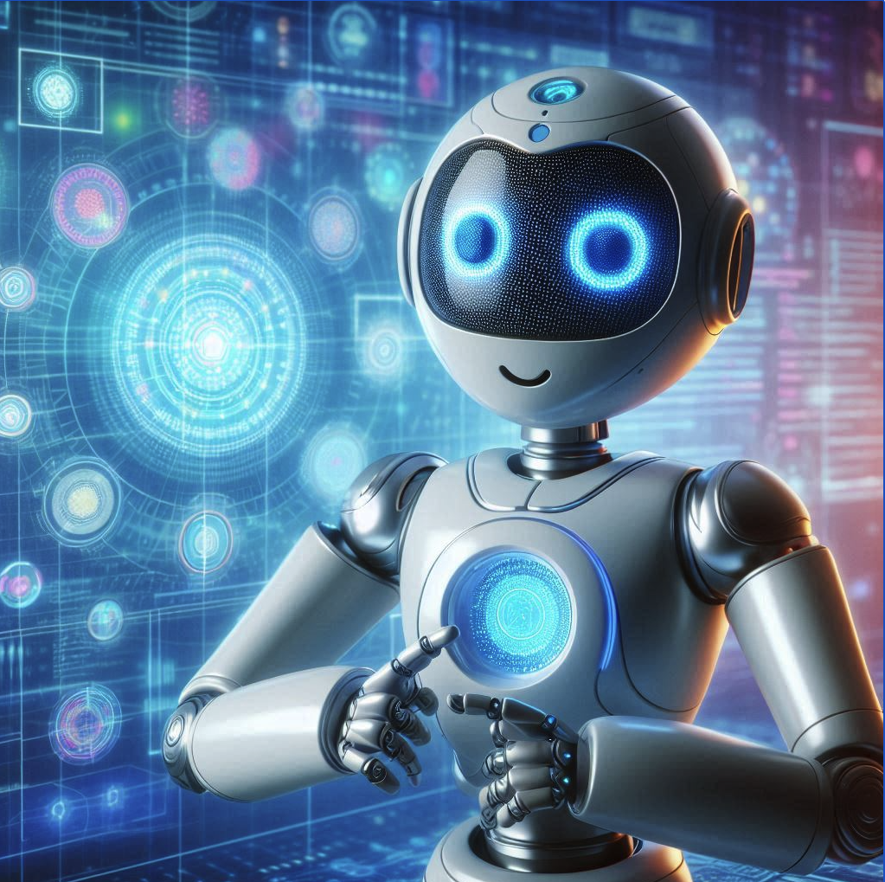
Table of Contents
1. Introduction
2. MMMU
3. MathVista
4. AI2D-RST
5. ChartQA
6. Doc VQA
7. ActivityNet
8. EgoSchema
From Microsoft Copilot: “An AI Assistant that uses Large Language Models”
Notes:
For a quick overview, this presentation will cover 7 visual understanding tasks. These 7 benchmarks were used by OpenAI to test GPT 4o on visual understanding tasks. I’ll first discuss these benchmarks and then look at some similarities and differences between the current standard and a benchmark I am proposing for testing the visual acuity of large language models. On the right I have an image generated by Microsoft Copilot based on the prompt to generate an AI Assistant that uses Large Language Models. Current LLMs have the ability to generate images which is something that I think can be leveraged with our LLM benchmark. I’ll go more into that later in the presentation

Slide 3
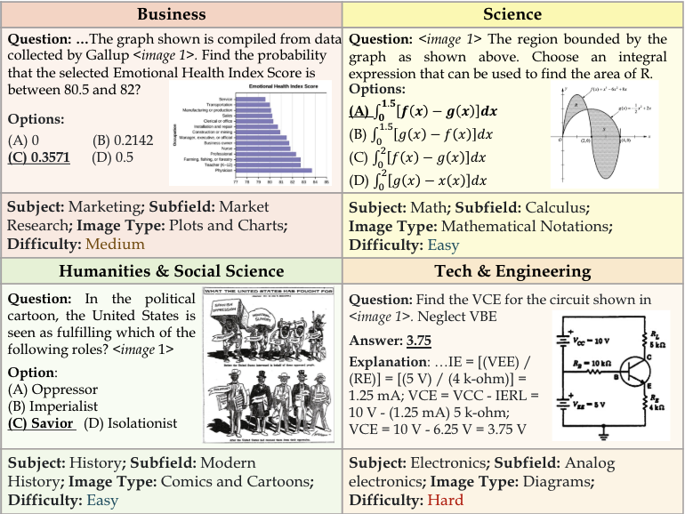
MMMU: Massive Multi-discipline Multimodal Understanding
Based on this paper
Tests multimodal models on massive multi-discipline tasks demanding college-level subject knowledge and deliberate reasoning
Over 11.5k questions spanning 30 subjects and 183 subfields, comprising 30 highly heterogeneous image types, such as charts, diagrams, maps, tables, music sheets, and chemical structures
Notes:
Taking a look at the current LLM benchmarks, I’ll start with MMMU. The goal of this benchmark is to test the LLM on different tasks based on different disciplines that require college-level knowledge. On the right I have some figures from the paper that disucsses this benchmark and as you can see some of these benchmarks include prompting the LLM with visual input and a prompt based on different fields such as Business, Science, the Humanities and Engineering or Tech. There are several more subjects as you can see on the right and the image types have a wide range.

Slide 4
MMMU: Authors and Contributors
1Xiang Yue*† , 2 Yuansheng Ni*, 3 Kai Zhang*, 4 Tianyu Zheng*, 3 Ruoqi Liu, 2 Ge Zhang, 3 Samuel Stevens, 2 Dongfu Jiang, 2 Weiming Ren, 4 Yuxuan Sun, 2 Cong Wei, 3 Botao Yu, 5 Ruibin Yuan, 2 Renliang Sun, 7 Ming Yin, 3 Boyuan Zheng, 4 Zhenzhu Yang, 6 Yibo Liu, 4 Wenhao Huang, 3 Huan Sun*, 3 Yu Su*† , 2 Wenhu Chen*†
1 IN.AI Research, 2 University of Waterloo, 3 The Ohio State University, 4 Independent, 5 Carnegie Mellon University, 6 University of Victoria, 7 Princeton University
*Core Contributors.
https://mmmu-benchmark.github.io/

Slide 5
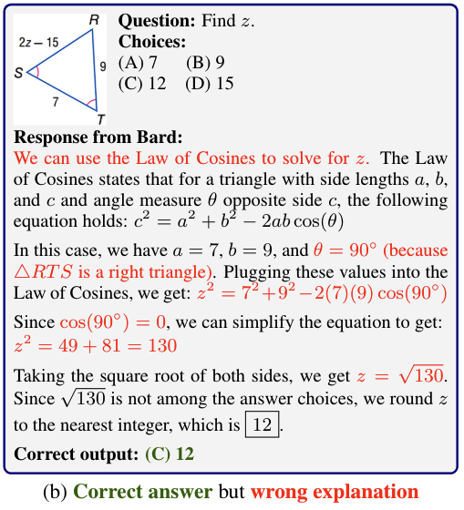
MathVista: Evaluating Mathematical Reasoning of Foundation Models in Visual Contexts
Based on this paper
Includes seven mathematical reasoning types: algebraic reasoning, arithmetic reasoning, geometry reasoning, logical reasoning, numeric common sense, scientific reasoning, and statistical reasoning
Notes:
Similar to MMMU, the MathVista benchmark gives the LLM visual inputs and prompts to test for mathematical reasoning. A good example of this can be seen on the right. This benchmark is more specific to mathematical reasoning as opposed to general academic questions we saw in MMMU. It tests LLMs on the seven mathematical reasoning types you see listed on the left.

Slide 6
MathVista: Authors and Contributors
Pan Lu 1,3 , Hritik Bansal 1 , Tony Xia 1 , Jiacheng Liu 2 , Chunyuan Li 3 , Hannaneh Hajishirzi 2 , Hao Cheng 3 , Kai-Wei Chang 1 , Michel Galley 3 , Jianfeng Gao 3
1 UCLA, 2 University of Washington, 3 Microsoft Research, Redmond
https://mathvista.github.io

Slide 7
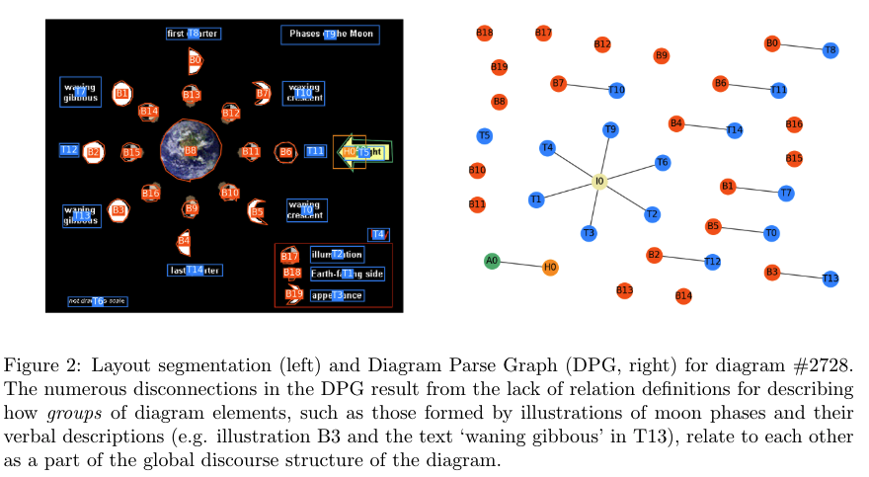
AI2D-RST: A multimodal corpus of 1000 primary school science diagrams
Based on this paper
Leverages AI2D-RST which is a corpus of 1000 English-language diagrams that represent topics in primary school natural sciences
Seeks to reduce the need for time and resources and to scale up the volume of data by building multimodally-informed expert annotations on top of pre-existing crowd-sourced annotations
Notes:
Next I’ll discuss a benchmark based on the Allen Institute for Artificial Intelligence Diagrams (AI2D) dataset called AI2D-RST. The RST portion of this benchmark is used to describe Rhetorical Structure Theory. The corpus presents a new multi-layer annotation schema that provides a rich description of their multimodal structure.The data are annotated by experts and each of the layers describe (1) the grouping of diagram elements into perceptual units, (2) the connections set up by diagrammatic elements such as arrows and lines, and (3) the discourse relations between diagram elements, which are described using Rhetorical Structure Theory (RST) and that’s where that term RST comes into play. This benchmark seems to follow a theme that I noticed when going through these papers of testing academic knowledge.

Slide 8
AI2D-RST: Authors and Contributors
Tuomo Hiippala, Malihe Alikhani, Jonas Haverinen, Timo Kalliokoski, Evanfiya Logacheva, Serafina Orekhova, Aino Tuomainen, Matthew Stone, John A. Bateman
https://github.com/thiippal/AI2D-RST

Slide 9
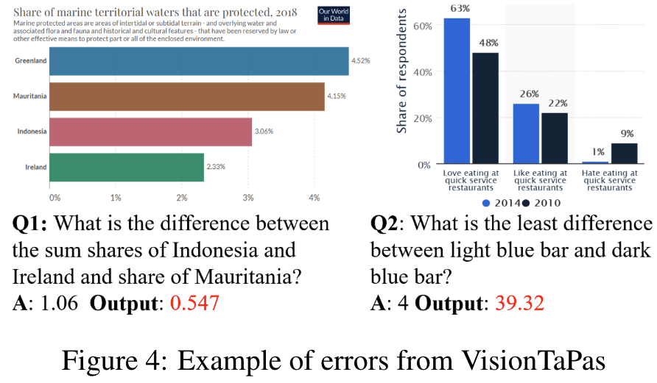
ChartQA: A Benchmark for Question Answering about Charts with Visual and Logical Reasoning
Based on this paper
a large-scale benchmark covering 9.6K human-written questions as well as 23.1K questions generated from human-written chart summaries.
The goal of a Chart Question Answering (ChartQA) system is to help users by taking a chart and a natural language question as input and predicting the answer
Notes:
Next is the ChartQA benchmark which is concerned with prompting the LLM with visual chart inputs and then questions and answers. The goal of the system is to predict the answer from the LLM based on the question and the chart. On the right you can see some examples of the type of questions and charts that were included.

Slide 10
ChartQA: Authors and Contributors
Ahmed Masry♣ , Do Xuan Long♠ , Jia Qing Tan♠ , Shafiq Joty♠♦, Enamul Hoque♣
♣York University, Canada, ♠Nanyang Technological University, Singapore, ♦ Salesforce Research, ♣ {masry20, enamulh}@yorku.ca , ♠ {xuanlong001@e.ntu, C190022@e.ntu, srjoty@ntu}.edu.sg
https://github.com/vis-nlp/ChartQA

Slide 11
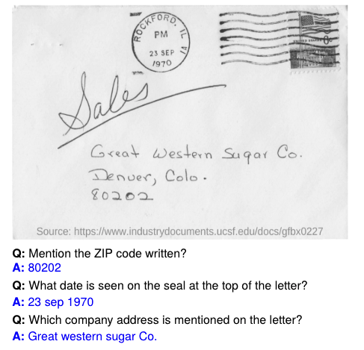
DocVQA: A Dataset for VQA on Document Images
Based on this paper
The DocVQA dataset consists of 50,000 questions defined on 12,000+ document images.
Reading systems should not only extract and interpret the textual (handwritten, typewritten or printed) content of the document images, but exploit numerous other visual cues including layout (page structure, forms, tables), as well as other non-textual elements.
Notes:
Another benchmark used by OpenAI was DocVQA. The image on the left is from the beginning of the paper of the same title that describes this benchmark and has both the letter as visual input, but also some questions about the image which are based on the description in the third bullet point on the right. Along with the description on the right, you can see that DocVQA is very large as a dataset which is a common theme across most of these benchmarks.

Slide 12
DocVQA: Authors and Contributors
Minesh Mathew 1 , Dimosthenis Karatzas 2 , C.V. Jawahar 1
1 CVIT, IIIT Hyderabad, India 2 Computer Vision Center, UAB, Spain
minesh.mathew@research.iiit.ac.in, dimos@cvc.uab.es, jawahar@iiit.ac.in
https://www.docvqa.org/

Slide 13
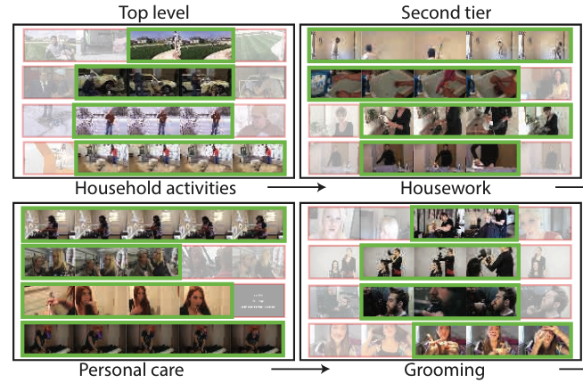
ActivityNet: A Large-Scale Video Benchmark for Human Activity Understanding
Based on this paper
The dataset offers a wide range of complex human activities that are of interest to people in their daily living. In its current version, ActivityNet provides samples from 203 activity classes with an average of 137 untrimmed videos per class and 1.41 activity instances per video, for a total of 849 video hours
Notes:
ActivityNet is the first of two benchmarks I’ll talk about which actually use video inputs. The primary inputs for the LLM in this benchmark are videos of different complex human activities that are of interest to people in their daily living. Some examples of these activities are on the right.

Slide 14
ActivityNet: Authors and Contributors
Fabian Caba Heilbron 1,2, Victor Escorcia 1, 2, Bernard Ghanem 2 and Juan Carlos Niebles 1
1 Universidad del Norte, Colombia 2 King Abdullah University of Science and Technology (KAUST), Saudi Arabia
http://activity-net.org/index.html

Slide 15
EgoSchema: A Diagnostic Benchmark for Very Long-form Video Language Understanding
Based on this paper
Derived from Ego4D, EgoSchema consists of over 5000 human curated multiple choice question answer pairs, spanning over 250 hours of real video data, covering a very broad range of natural human activity and behavior. For each question, EgoSchema requires the correct answer to be selected between five given options based on a three-minute-long video clip
Notes:
Finally, the second benchmark using video inputs is EgoSchema which is similar to ActivityNet but has the primary focus of using videos in a very long format to test video language understanding. One thing I found interesting about this benchmark was how the answer choices were multiple choice as opposed to giving the LLM an open-ended question. I’m not 100% sure how this would affect the other benchmarks if a similar format was used but I thought it was interesting that the questions were posed in this way for this particular visual knowledge task.

Slide 16
EgoSchema: Authors and Contributors
Karttikeya Mangalam, Raiymbek Akshkulakov, Jitendra Malik
UC Berkeley {mangalam, raiymbek, malik} @eecs.berkeley.edu}
https://egoschema.github.io/

Slide 17
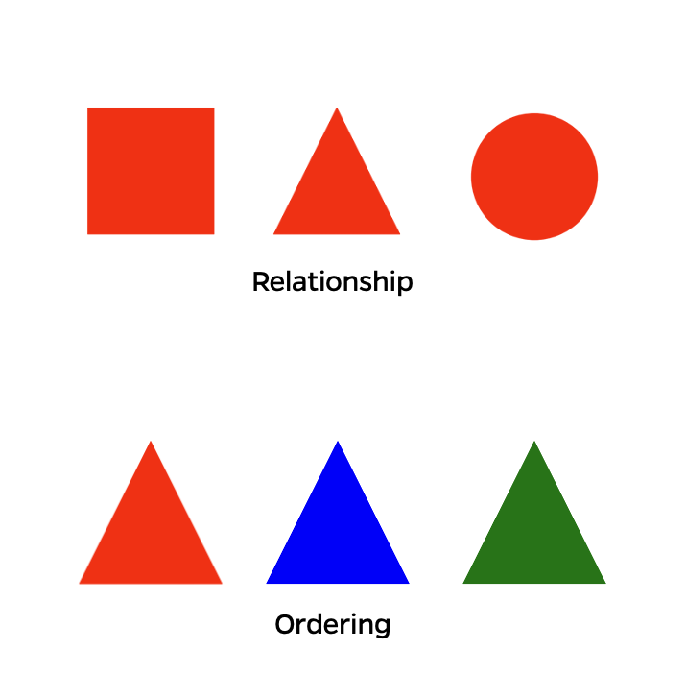
Proposed Visual Understanding Benchmark
Should include characteristics of OpenAI benchmark – multiple subjects, image types and question types
Benchmark will test LLMs in a way that will allow for results to be easily measured or compared
Notes:
Now I would like to look at the visual understanding benchmark I am trying to develop for testing these large language models on visual tasks similar to the ones from the Open AI benchmark. I gave a very brief presentation on what this benchmark might look like during one of our first meetings this summer. The image on the right is from that presentation. What this benchmark aims to do is push the capabilities of LLMs with regard to visual understanding. I feel the OpenAI benchmark is a great foundation to start on, but I think this benchmark will expand on it and add different features to gain more understanding about LLMs. I’ll go more into these features on the next slide and compare them with what OpenAI demonstrated with these benchmarks for GPT 4o

Slide 18
Comparing Benchmarks: OpenAI Visual Tasks vs UF Data Studio Visual Acuity Benchmark
OpenAI
- Benchmarks with academic images and questions
- Images generated by humans
Our Benchmark
- Benchmarks with images and questions that are not necessarily academic
- Images generated by humans and Generative AI
Notes:
I tried using a Venn Diagram for this slide which worked to an extent, but I was not able to add text in the intersection of the two sets. For things that our benchmark will have in common with OpenAI is leveraging large datasets. To be a test that can verify the capabilities of LLMs, I think that our benchmark should use some of the datasets from OpenAI to have as much visual input data for the benchmark as possible. Along with data, our benchmark will also have several different image and question types. While our benchmark will share these characteristics of the OpenAI benchmark it will have some differences which you can see in the diagram. TALK ABOUT THE DIFFERENCES

Slide 19
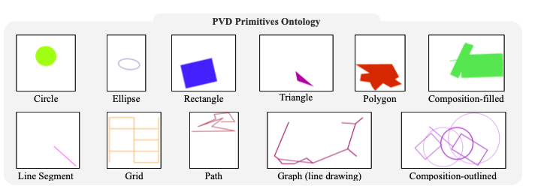
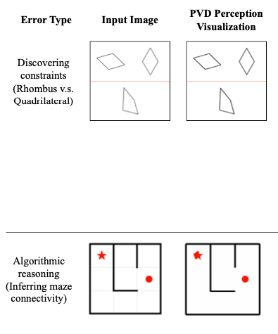
Features of Proposed Visual Understanding Benchmark
Physical Characteristics
Qualities like shape, color, size, etc.
Basic Geometric inputs
Multi-shape inputs
Visual input and prompt defined by a schema:
Primitive visual inputs from this paper
LLM Reasoning tests
Example schema from same paper
Notes:
There’s a lot on this slide, but I want to focus on not just the abstract comparison of the features of our proposed visual understanding benchmark, but also look at some tests that our benchmark should include. I’ll go ahead and mention that all of the images and examples from this slide are taken from a paper titled Text-Based Reasoning About Vector Graphics which I’ve linked under the first example. I still need to read the paper in its entirety, but skimming through sections of it I found that a lot of what the researchers did in those experiments can be used in a similar way for a visual understanding benchmark. Our benchmark will test the LLM on knowledge of physical characteristics using basic geometric inputs that can include one or more shapes. I really liked this paper's use of JSON formatting to create user-defined schemas for different types of shapes and visual inputs. There’s an example of this on the bottom right of the slide. I know Dr. Grant and I have discussed previously creating a table of possible combinations of characteristics for different types of visual inputs that our benchmark could use and I think this could be a example to follow. Obviously the technology being used can differ but I like the spirit of the tests done in this paper. Again I’ve linked it here on the slide and you can see some of the examples of visual inputs they used for their experiments.
‘

Slide 20
Notes:
Thank you for sticking with me through this talk. If anyone has any questions about some of the tasks, our benchmark or any specific part of the talk I’ll be happy to go back and answer those.

