Slide 1
Guided Undergraduate Training for Shark Segmentation (GUTSS)
Amy Wu
Notes:
App for XYZ, how it looks like, introduce to them
Questionnaire -> let students take pics during dissections and tell us what you think about it
Mockup ^ have a camera with a pic of the dissected body with stuff highlighted over (2 frames)
Do you have any ideas/suggestions on how you do it

Slide 2
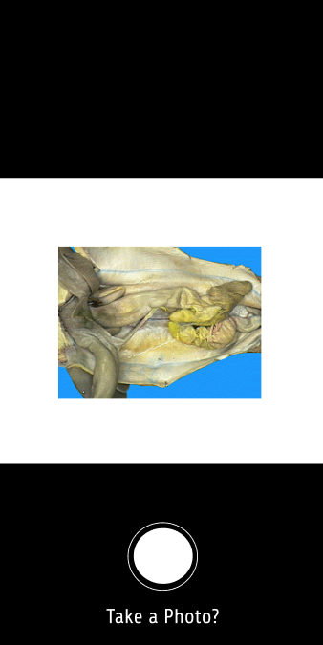
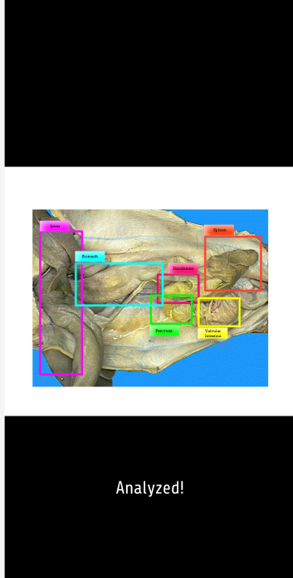
Figma Mockup
Annotating before screen here
Annotating after screen here
Notes:
Tool for anatomy class in different methods
Teachers would use it as a guide for the instructors
Use app to collect data and some animals would have anomalies so we can collect those for research/learning
Use cases ^ learning, instruction plans, teaching
Any screenshots to make the vision come to life?
Button on detecting anomaly (have a part of the app to label/select where it would be out of the ordinary)
One more screen on the teacher’s view (how do you evaluate all the pictures that are taken)
1 central model vs multiple of models
Android/Ios? Model IOS
Top of the picture on the right for annotation boxes, red eye, zoom bar floats, add/edit annotations/ explore, also have one for sharing
Have two screens one for annotating before and one for annotating after, with sharing afterwards

Slide 3
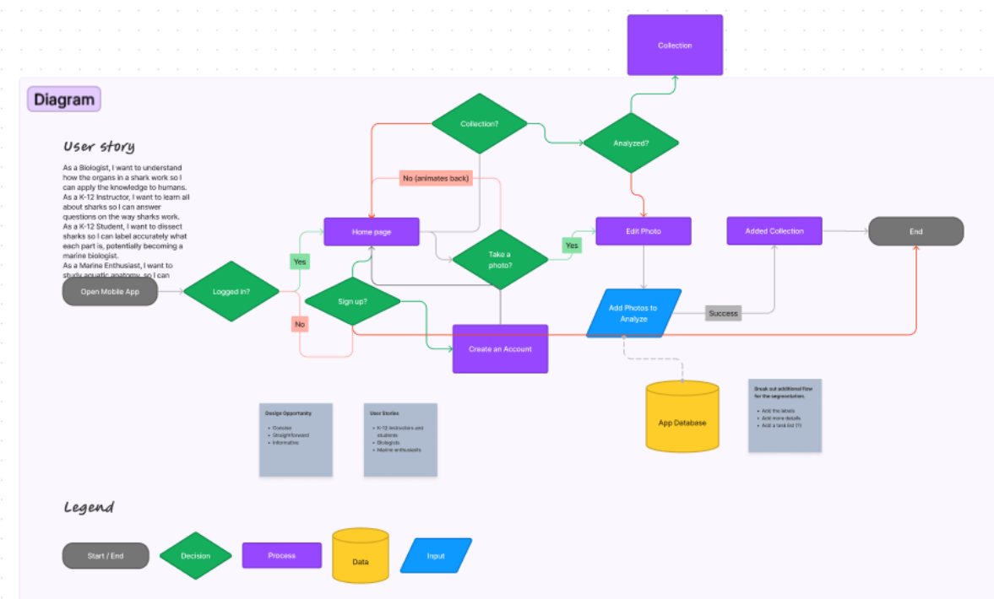
Figma Flowchart

Slide 4
Research Question
How can instructors use segmentation tool for anatomy-related course work?
Notes:
Constrain AI to a definition
Some ideas of what AI would be used; no want for biased answers
Think of what you would want to get from; help guide your measurement tools with it
No need for open-ended questions if we want no open-ended answers
Fill in the blank or a scale or make sure to constrain the answers/ imagination as much as possible
Make sure everyone is on the same page; we’ll also put the Figma screenshots into the questionnaire
More general questions at the beginning and more specific questions too
Demographic good, ask on educational background and the number of students that they will teach in their class specifically on anatomy and shark biology, stay general on AI and their experience using it for education, perceived notions on AI want to know where they stand, ask if they can see a use case for anatomy for the lecture modules, guide what features that they would choose
Here’s an example of the app at the end give us your thoughts could you use it how you would use it and what is missing.
Collaborating with teachers on AI (mutually beneficial environment) -> focus here
What application would they see? What it should look at?
What experience do we want; measuring what we want for them
Would this be helpful for you any ideas of how it can help you

Slide 5
Potential Survey: Demographics
What is your name?
What is your UFL.edu email?
What is your major?
What is your age?
What is your ethnicity?

Slide 6
Potential Survey: AI Background
Have you used AI before outside of your classroom?
Have you used AI before in your classroom?
If yes, what have you used AI for?
Where would you like to implement AI in?
How would you like to implement AI?
What are your expectations in utilizing AI?
What are some potential drawbacks to using AI?

Slide 7
Potential Survey: AI Background Alt
Using a Likert scale for:
I like AI.
I have no concerns on AI.
I think AI is helpful for students with accessibility issues.
I think students learn faster with AI.
I think students retain lesson material better with AI.
I think AI can help me teach students more efficiently.
I think AI will help students perform better in academics.

Slide 8
Potential Survey: Perspectives
How do you feel using technology to learn anatomy?
What would you like to see in an AI tool for anatomy?
What can AI do to help anatomy material retention?
What are some potential issues in using an AI tool in anatomy?
How would you face technical problems in using AI in anatomy?
What concerns do you have in using an AI tool within anatomy?
How would you expect the students react to an AI anatomy tool?

Slide 9
Potential Survey: Questions?
Likert scale?
Mann-Whitney Test?
ANOVA Test?
Qualitative coding/ thematic analysis?

