Slide 1
Automatic Speech Recognition
Zachary Sayers

Slide 2
Early Beginnings
The first machine that recognized speech was a toy from the 1920s. “Radio Rex”
Since 500 Hz is roughly the first formant of the vowel [eh] in “Rex”, Rex seemed to come when he was called
Notes:
A spring was programmed to release when it picked up on vibrations of 500 Hz of acoustic energy

Slide 3
Speech Types and Variations
Types | Variations
Read speech, in which humans are reading out loud The speech of two or more humans talking to each other is conversational speech | Channel and noise Accent or speaker-class characteristics.
Notes:
Read speech (easiest for models to recognize) and very formal (scripted) Ex: Audio from an audio book
Conversational speech is the hardest for models to understand because speech is more informal and multiple voices are transcribed Ex: a zoom meeting
Channel and noise: Speech is easier to recognize if it’s recorded in a quiet room with head-mounted microphones than if it’s recorded by a distant microphone on a noisy city street, or in a car with the window open.
Accents: Speech is easier to recognize if the speaker is speaking the same dialect or variety that the system was trained on.

Slide 4
Publicly available corpora with human-created transcripts
Name | Attributes
LibriSpeech | a large open-source read-speech 16 kHz dataset with over 1000 hours of audio books from the LibriVox project, with transcripts aligned at the sentence level
Switchboard | (1990s) telephone conversations between strangers collected in the early 1990s; it contains 240 hours of 8 kHz speech and about 3 million words
CALLHOME | (1990s) 120 unscripted 30-minute telephone conversations between native speakers of English
CORAAL | over 150 sociolinguistic interviews with African American speakers, with the goal of studying African American Language (AAL), the many variations of language used in African American communities
HKUST | 1206 ten-minute telephone conversations between speakers of Mandarin across China
AISHELL1 | 170 hours of Mandarin read speech of sentences taken from various domains, read by different speakers mainly from northern China

Slide 5
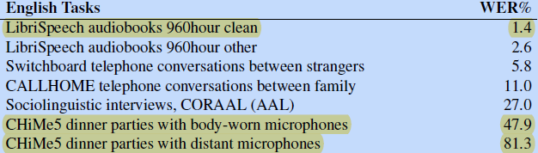
ASR Word Error Rates (2020 Report)
Notes:
Audio with only one person speaking into a clear mic had a WER percentage of under 2% while ASR models struggled to transcribe audio with sociolinguistic variations like African American Vernacular English and party speech accurately

Slide 6
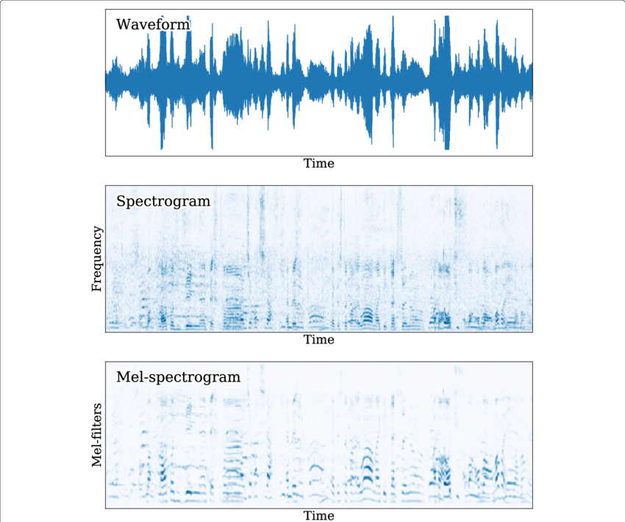

Extracting Audio for ASR
We use the raw waveform of the audio and transform it into a spectrogram using a discrete Fourier transformation (generates the frequency and magnitude of the audio).
Because humans hear on a logarithmic scale, we do a log transformation on the raw frequency of the audio creating the “log Mel Spectrogram” (a Mel is a unit of pitch).
Notes:
We visualize spectrums by plotting magnitude against the frequency.

Slide 7
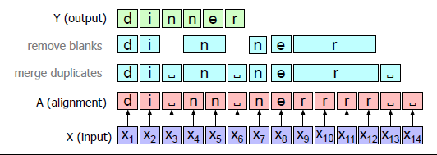
Speech Recognition Architecture
Connectionist Temporal Classification (CTC)
Frequency of frames in Mel spectrograms are evaluated and each frame gets assigned a letter or character (x1 ,x2, ...) (tokens)
Using the CTC algorithm in alignment, characters that have duplicates next to them without blanks (spaces) between them are merged
Blanks are removed
The characters that are left are joined for a word (output)
Notes:
Blanks represent spaces or pauses in the word

Slide 8
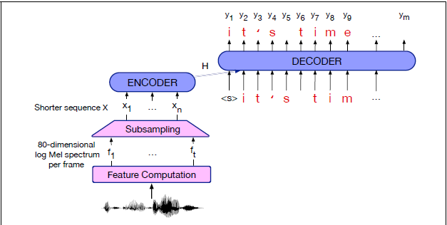
Speech Recognition Architecture
Attention-based encoder decoder (AED)

Slide 9
CTC vs AED
CTC | AED
A CTC algorithm can input letters from left to right immediately Great for auto-generation/transcription of words while a speaker is still speaking (captions) Less accurate than AED due to its use of time intervals between words to piece them together | Algorithms that use attention need to compute the hidden state sequence over the entire input first in order to provide the attention distribution context, before the decoder can start decoding Encoder-decoder function produces a more accurate transcript than CTC transcription

Slide 10
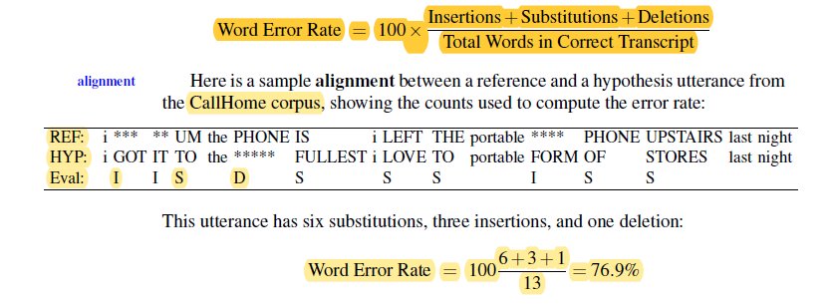
ASR Evaluation: Word Error Rate
The standard method for computing word error rates is a free script called Sclite.
Notes:
For error analysis Sclite gives useful information such as confusion matrices showing which words are often misrecognized for others and summarizes statistics of words that are often inserted or deleted. Sclite also gives error rates by speaker (if sentences are labeled for speaker ID), as well as useful statistics like the sentence error rate, and the percentage of sentences with at least one word error.

Slide 11
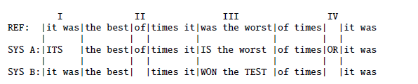
ASR Evaluation: Matched-Pair Sentence Segment Word Error (MAPSSWE)
The MAPSSWE test is a parametric test that looks at the difference between the number of word errors two systems produce, averaged across a number of segments.
Could be used to see if the zoom transcription is better or worse at transcribing Indian-English compared to my fine-tuned model

