Slide 1
GUTSS: Grounding Dino
Amy Wu
07/19/2023

Slide 2
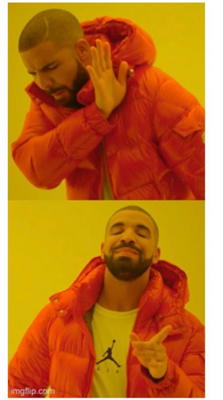
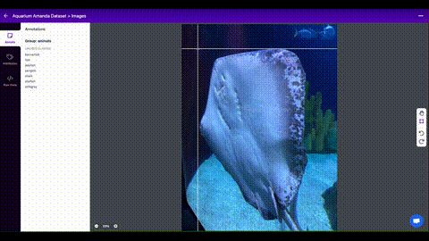
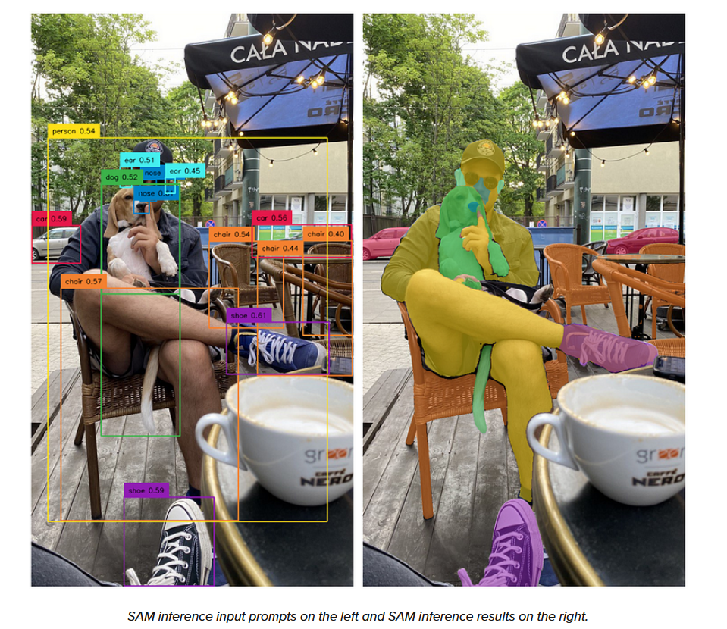
Introduction
What is Grounding Dino? A zero-shot detector (detects without retraining)
Connection to SAM? Gathers input to label and sends it to SAM to detect
Removes the need to label and annotate manually

Slide 3
Description
Text & Image Backbone
Feature Enhancer
Language-guided query selection
Cross-modality decoder

Slide 4
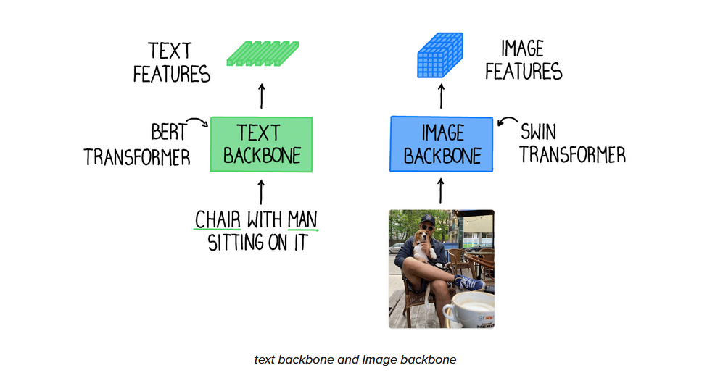
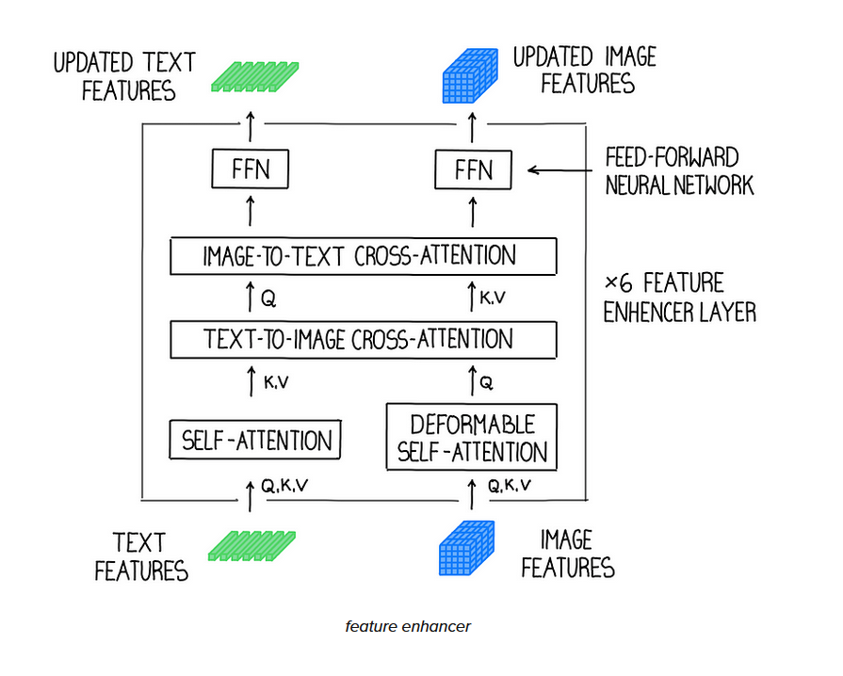
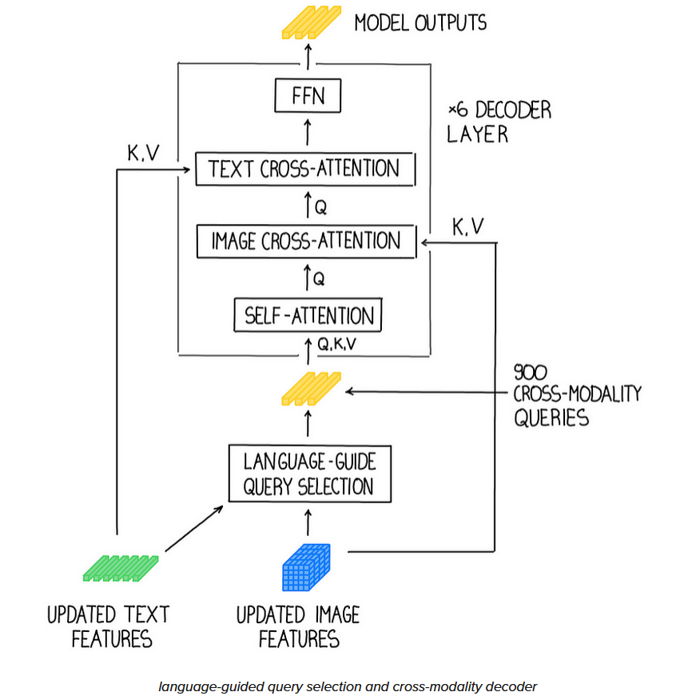
Diagrams
Text & Image Backbone
Feature Enhancer
Language-guided query selection
Cross-modality decoder

Slide 5
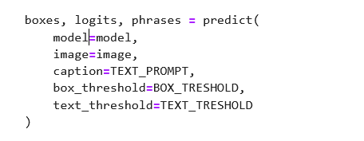
Grounding Dino Prediction
What does the parameters do for prediction?
Model: the model utilized
Image: the image fed in
Caption: what the box will describe
Box_threshold: the box size
Text_threshold: the input text

Slide 6
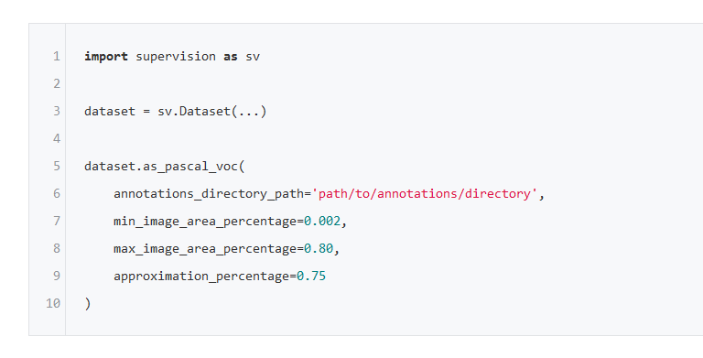
Grounding Dino Annotation
What does the parameters do for supervision annotation?
Min Area Percentage
Sets the least number of points in your polygon annotation
Max Area Percentage
Sets the most number of points in your polygon annotation
Approximation Percentage
Sets the size of the annotation files

Slide 7
Grounding Dino Types

Slide 8
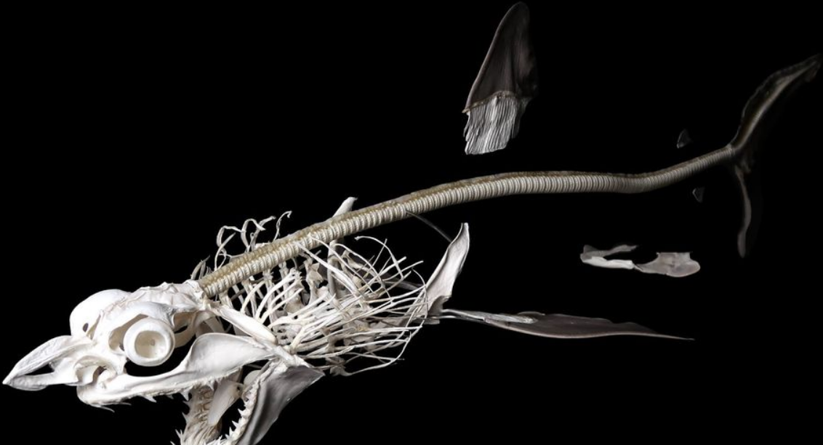
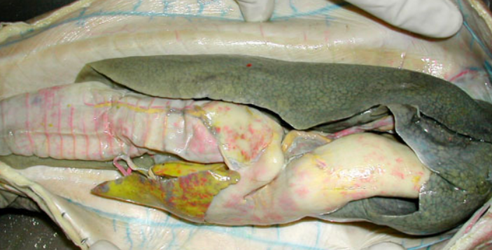
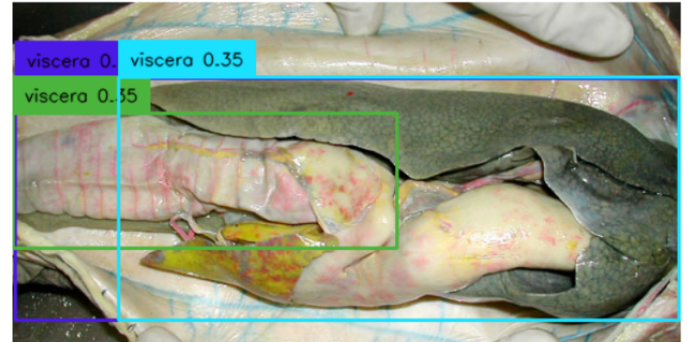
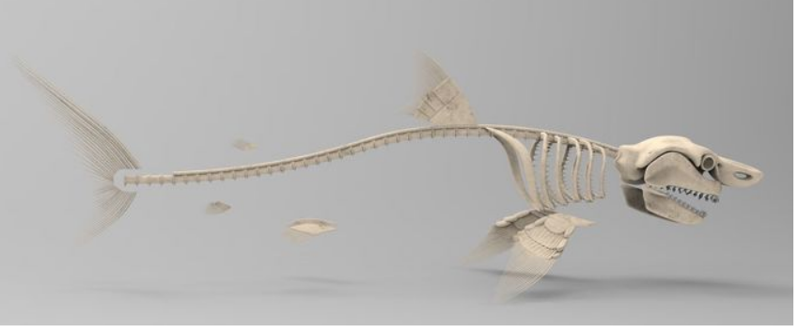
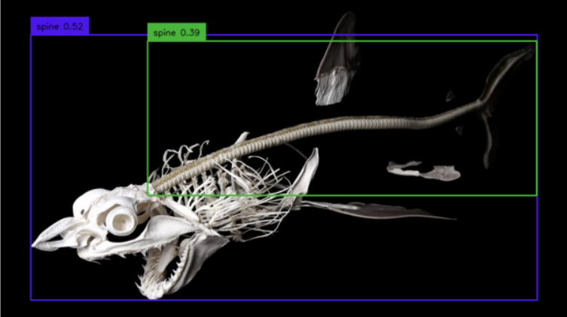
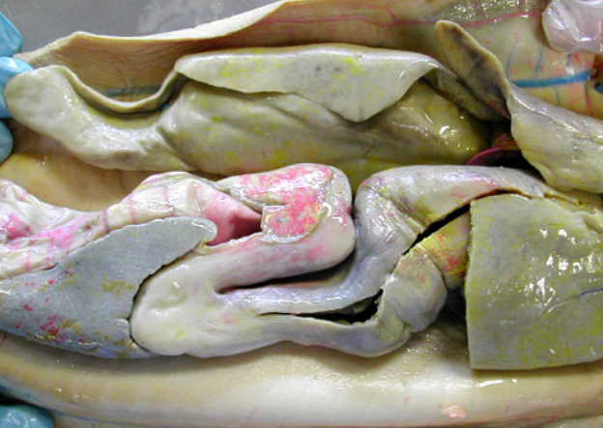
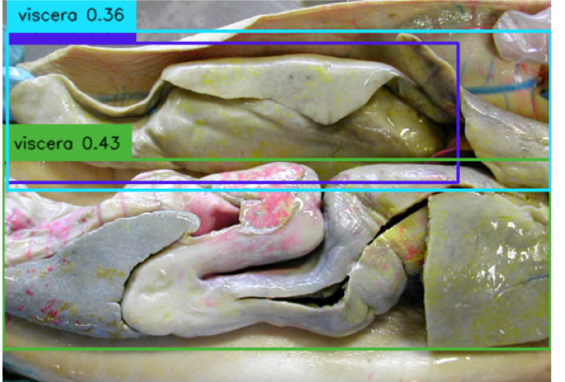
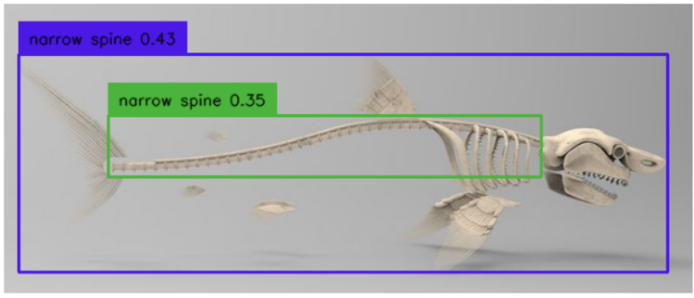
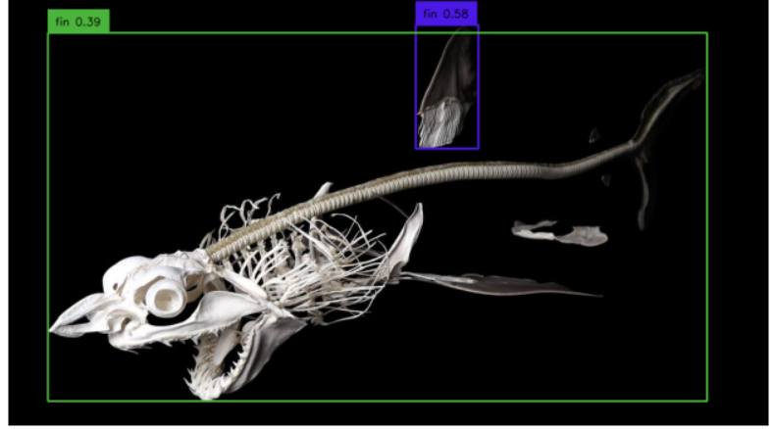
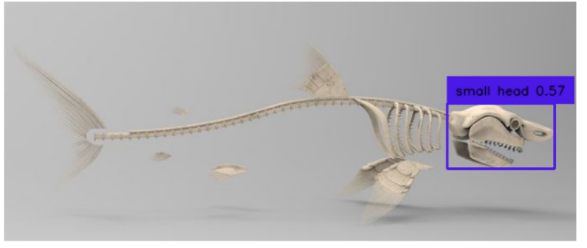
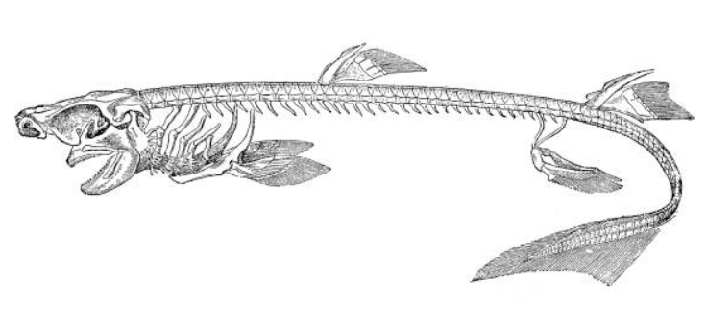
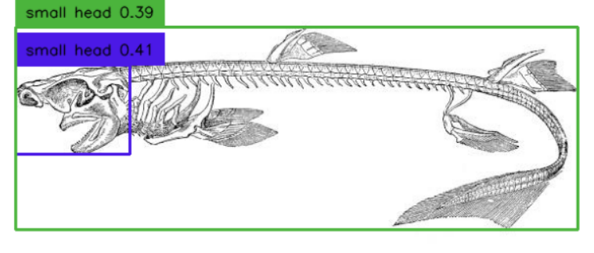
Grounding Dino Labeling
Notes:
Look for how it can be utilized by students to engage them in ai in a classroom setting and talk to them how the segmentation works
Comparison of collegiate faculty and to teachers
Muscle for bio
Skeleton for archaeology
Dissections in a classroom K-12 highschool
Think what a tool would look like; have to submit it for the IRB
Mobile app/ desktop top/ VR/ AR app and how to use it

Slide 9
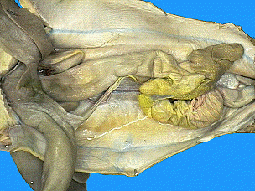
Grounding Dino Labeling
Liver
Spleen
Stomach
Duodenum
Pancreas
Valvular
Intestine
Notes:
Look for how it can be utilized by students to engage them in ai in a classroom setting and talk to them how the segmentation works
Comparison of collegiate faculty and to teachers
Muscle for bio
Skeleton for archaeology
Dissections in a classroom K-12 highschool
Think what a tool would look like; have to submit it for the IRB
Mobile app/ desktop top/ VR/ AR app and how to use it

