Slide 1
Visualization Through Deconvolution
Alexander R. Webber

Slide 2
Introduction
Zeiler 2012

Slide 3
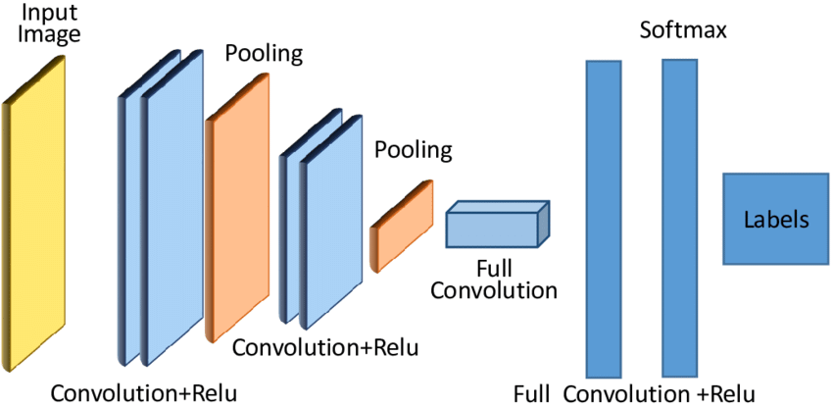
CNN

Slide 4
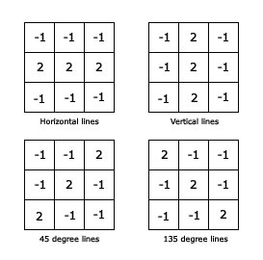
Convolution

Slide 5
Rectification / ReLU

Slide 6
Max Pooling

Slide 7
Unpooling

Slide 8
Rectification / ReLU

Slide 9
Deconvolution

Slide 10
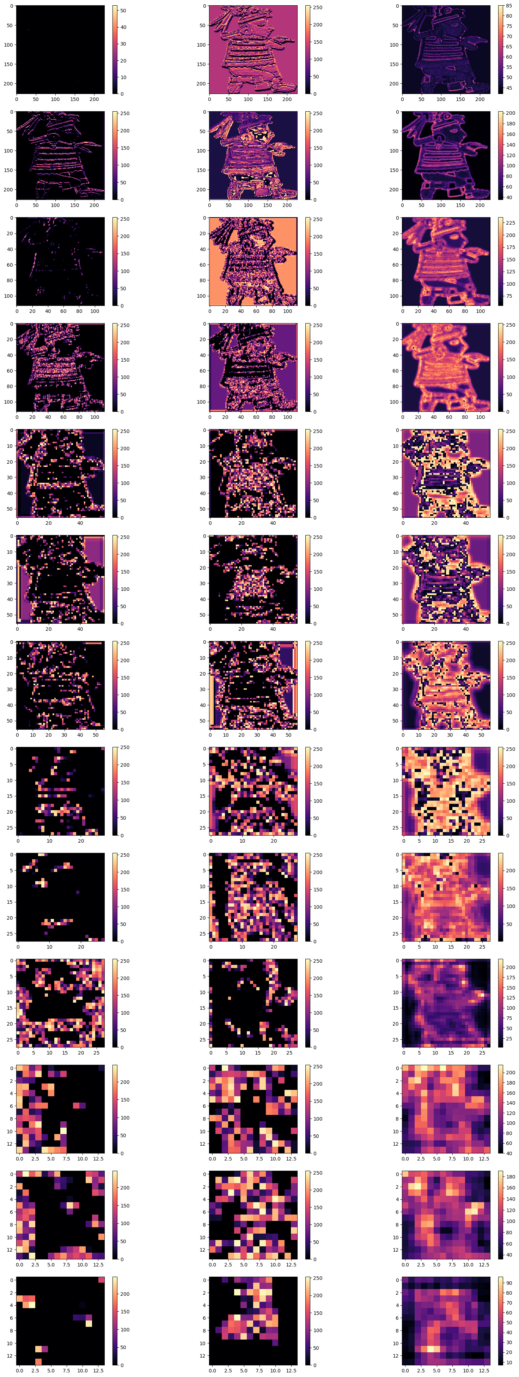
Example

