Slide 1
Relation and Event Extraction
Alexander R. Webber

Slide 2
Introduction

Slide 3
Relation Detection – Pattern Matching

Slide 4
Relation Detection – Supervised
Word Features
Named Entity Features
Syntactic Structure Features

Slide 5
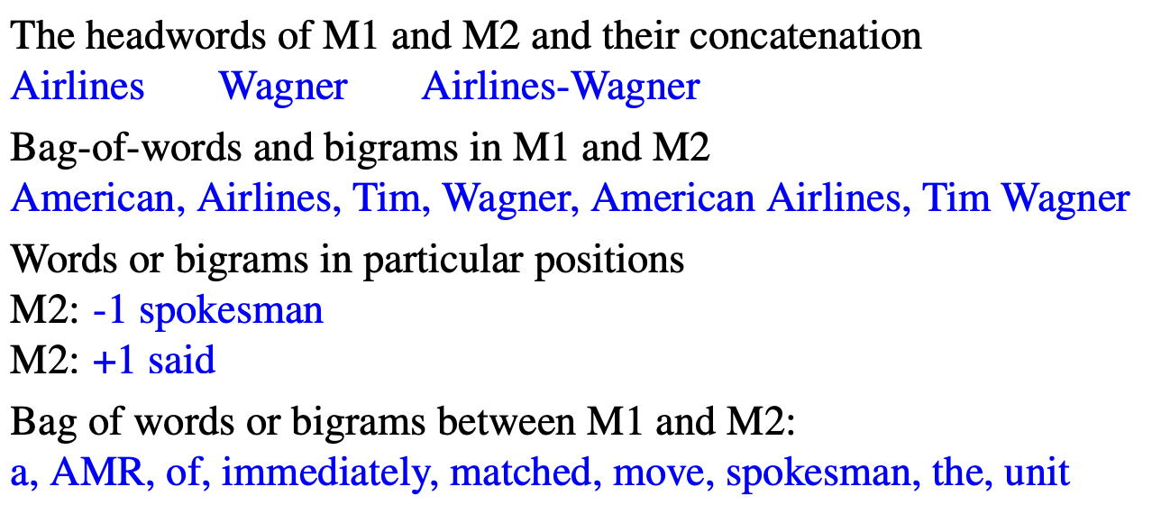
Relation Detection – Supervised
Word Features

Slide 6
Relation Detection – Supervised
Named Entity Features

Slide 7
Relation Detection – Supervised
Syntactic Structure Features

Slide 8
Relation Detection – Semisupervised
Boostrapping

Slide 9
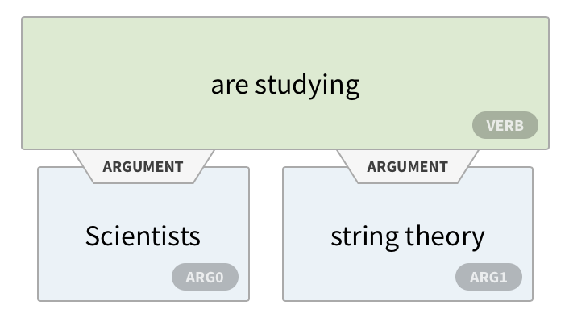
Relation Detection – Unsupervised
ReVerb
Scientists are studying string theory
Notes:
Run a part-of-speech tagger and entity chunker over s 2. For each verb in s, find the longest sequence of words w that start with a verb and satisfy syntactic and lexical constraints, merging adjacent matches. 3. For each phrase w, find the nearest noun phrase x to the left which is not a relative pronoun, wh-word or existential “there”. Find the nearest noun phrase y to the right. 4. Assign confidence c to the relation r = (x,w, y) using a confidence classifier and return it. A relation is only accepted if it meets syntactic and lexical constraints. The syntactic constraints ensure that it is a verb-initial sequence that might also include nouns (relations that begin with light verbs like make,

Slide 10
Event Extraction - Template Filling
Notes:
The task is generally modeled by training two separate supervised systems. The first system decides whether the template is present in a particular sentence. This task is called template recognition or sometimes, in a perhaps confusing bit of template recognition terminology, event recognition. Template recognition can be treated as a text classification task, with features extracted from every sequence of words that was labeled in training documents as filling any slot from the template being detected. The usual set of features can be used: tokens, embeddings, word shapes, part-of-speech tags, syntactic chunk tags, and named entity tags.
The second system has the job of role-filler extraction. A separate classifier is role-filler extraction trained to detect each role (LEAD-AIRLINE, AMOUNT, and so on). This can be a binary classifier that is run on every noun-phrase in the parsed input sentence, or a sequence model run over sequences of words. Each role classifier is trained on the labeled data in the training set. Again, the usual set of features can be used, but now trained only on an individual noun phrase or the fillers of a single slot.

