Slide 1
Applications of AI
A UF Data Studio Production
Alexander R. Webber
https://www.linkedin.com/in/worldwidewebber/

Slide 2
Outline
UF Data Studio
EarSketch
Games
Sentiment Analysis
Time Series
Health Care
ChatGPT

Slide 3
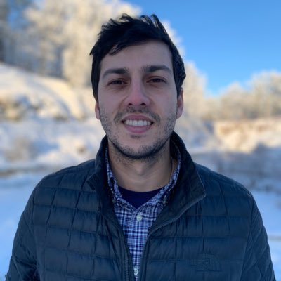
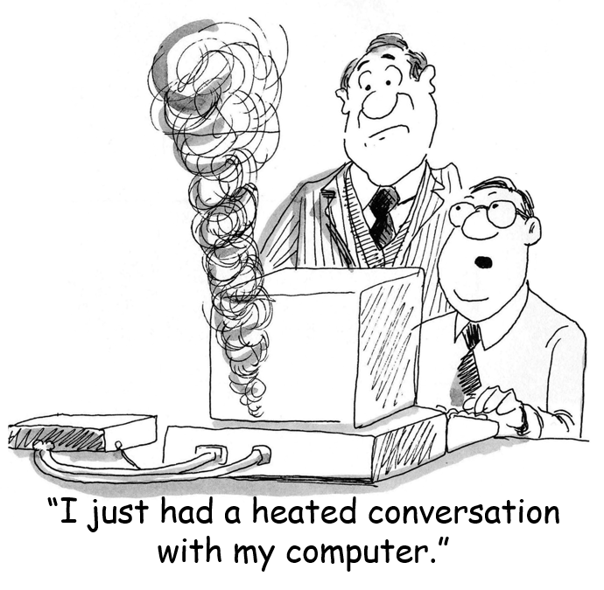
About Me
PhD Student in CS @ UF
BA in Linguistics @ UF
Research focus:
NLP
Computer Vision
Simulation
Genn 2015

Slide 4
Mixtec Codices Narrative Transcription

Slide 5
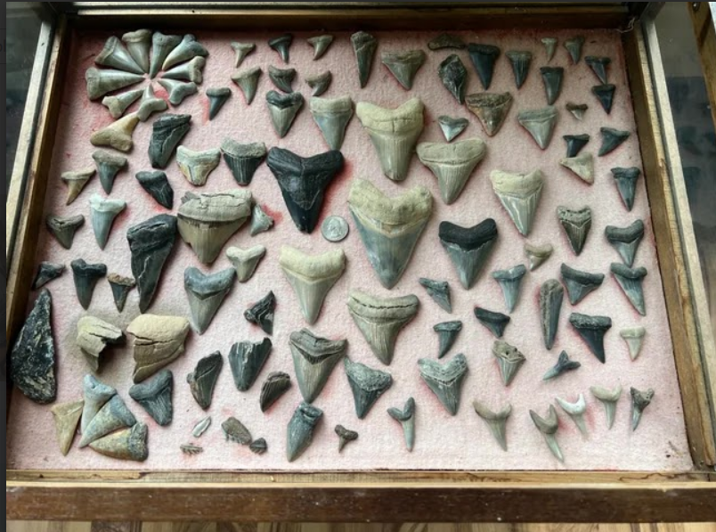
Shark Teeth AI

Slide 6
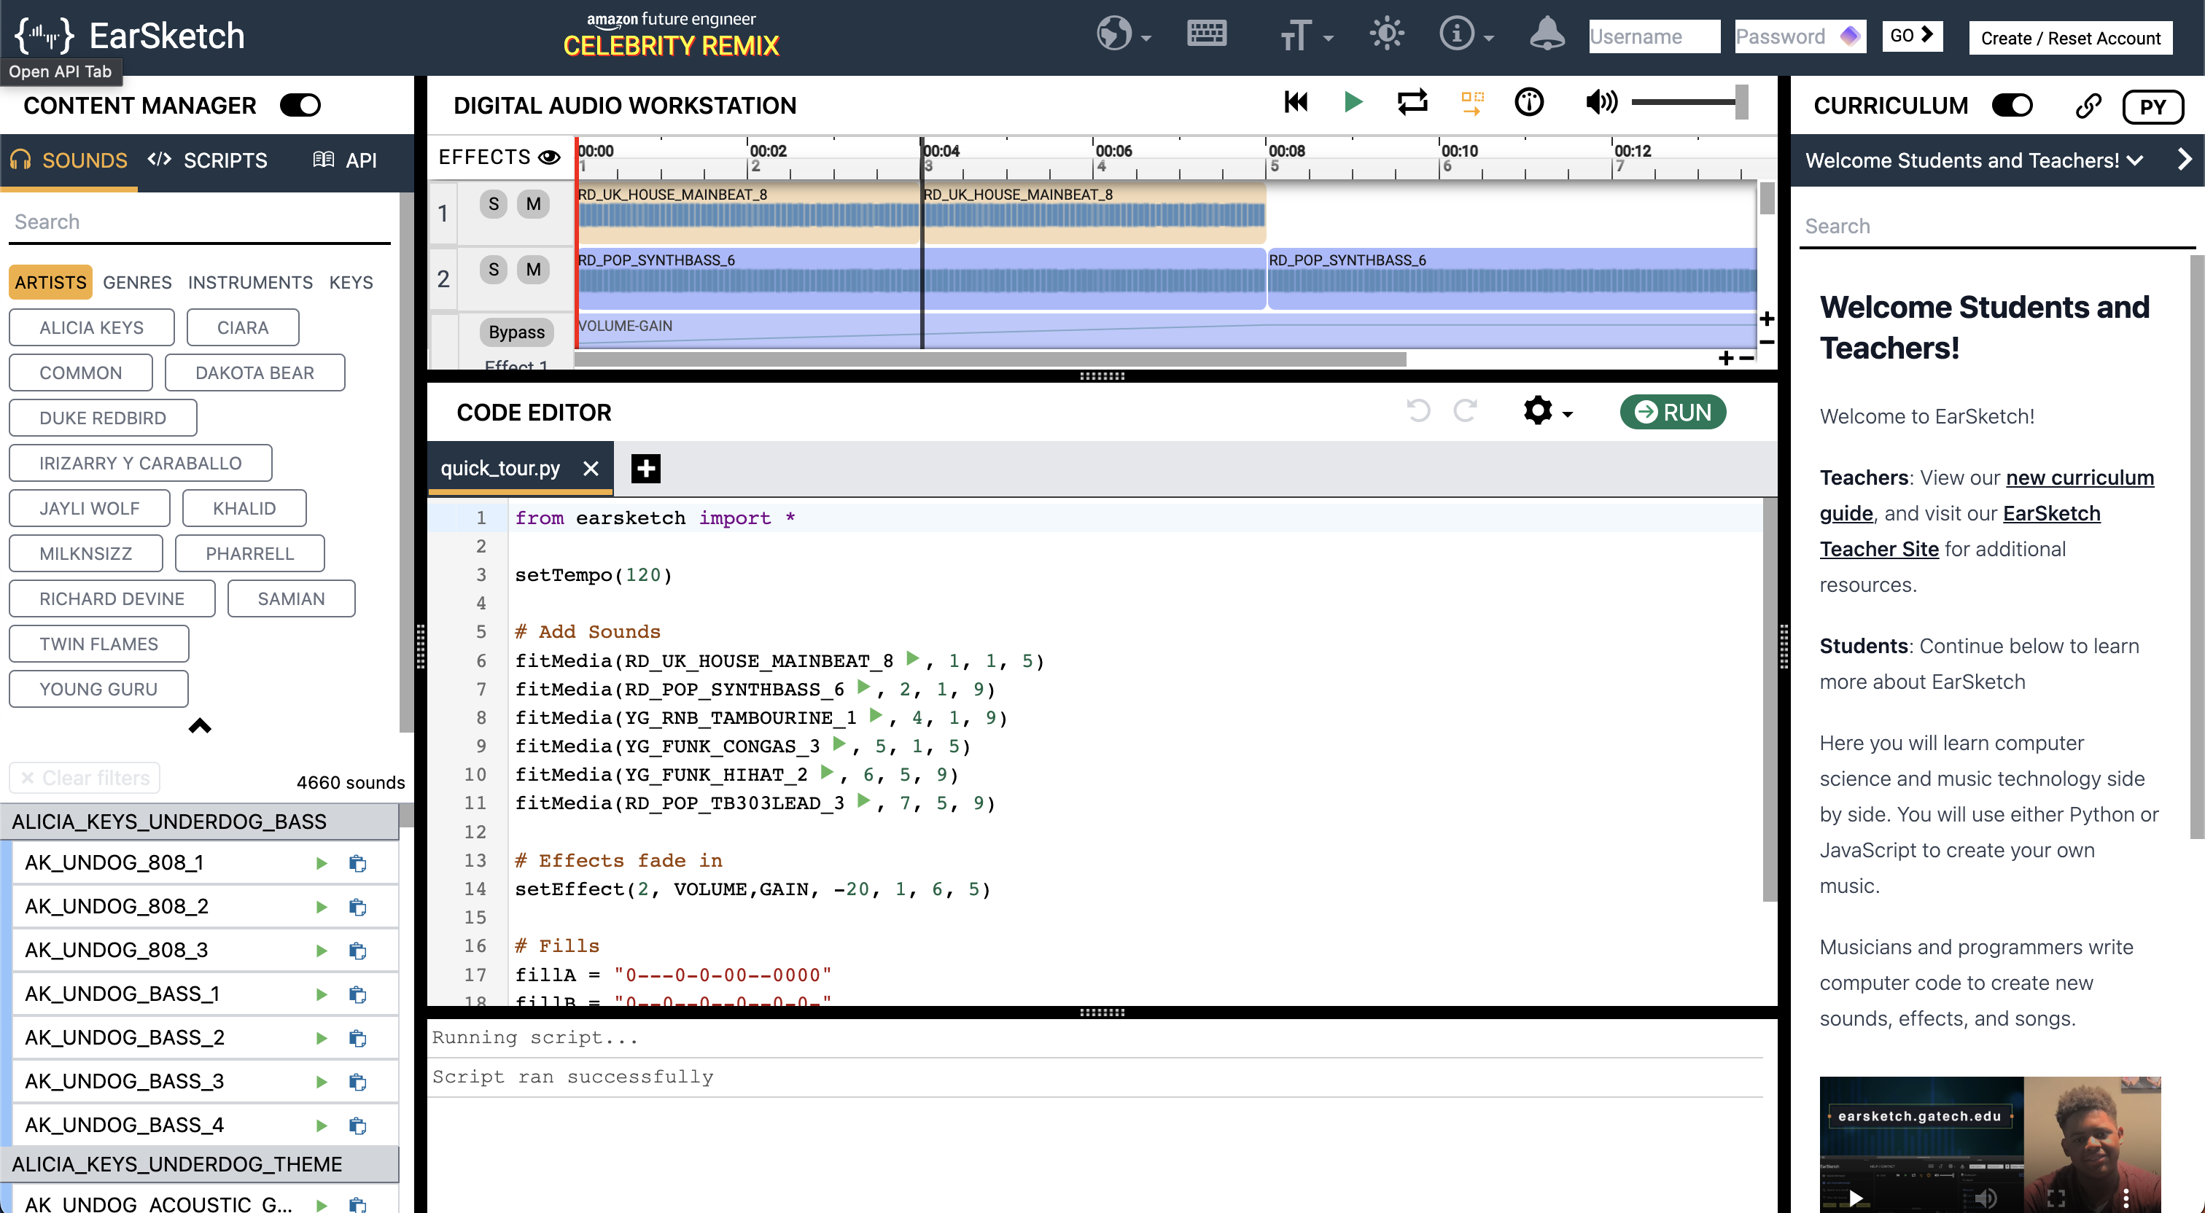
EarSketch
Magerko 2016

Slide 7
EarSketch
Katuka 2022

Slide 8
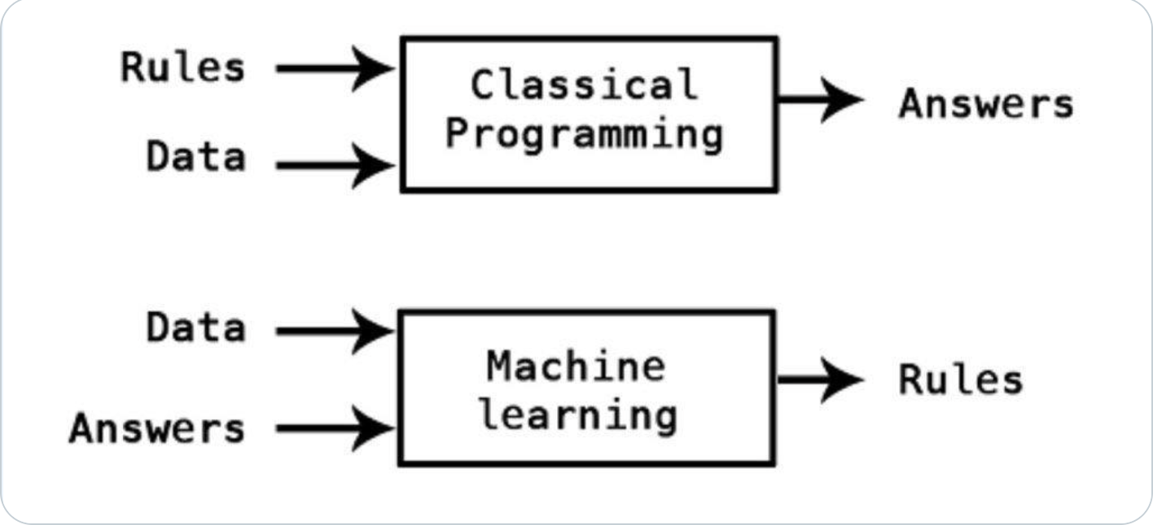
”AI”
Verma 2021

Slide 9
Games (Chess)
Campbell 2002

Slide 10
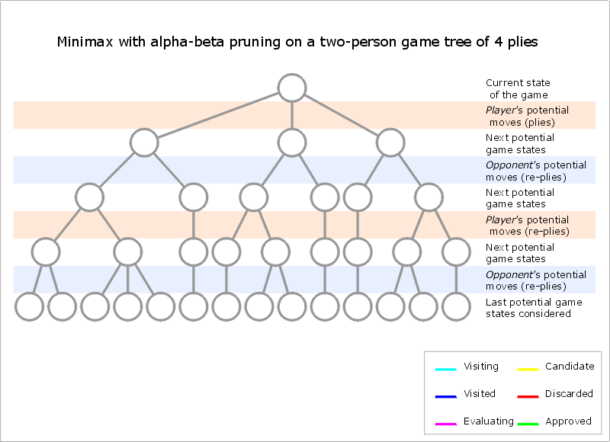
Games (Chess)
By Maschelos (talk) - Wikipedia

Slide 11
Games (Go)
Silver 2016
Notes:
Cite Dreyfus

Slide 12
Games (Go)
Surag 2017

Slide 13
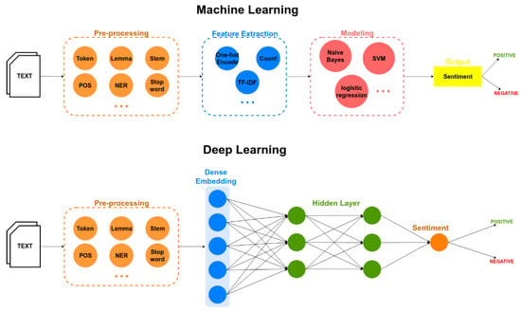
Sentiment Analysis (Language)
Dang 2020

Slide 14
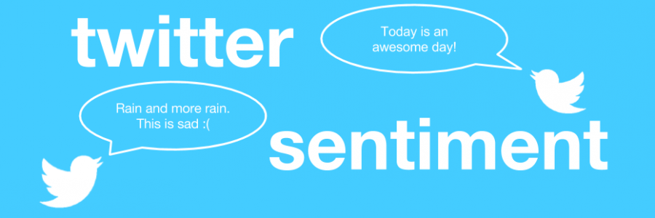
Sentiment Analysis (Language)
Doshi 2019

Slide 15
Sentiment Analysis (Vision)
Lee 2011

Slide 16
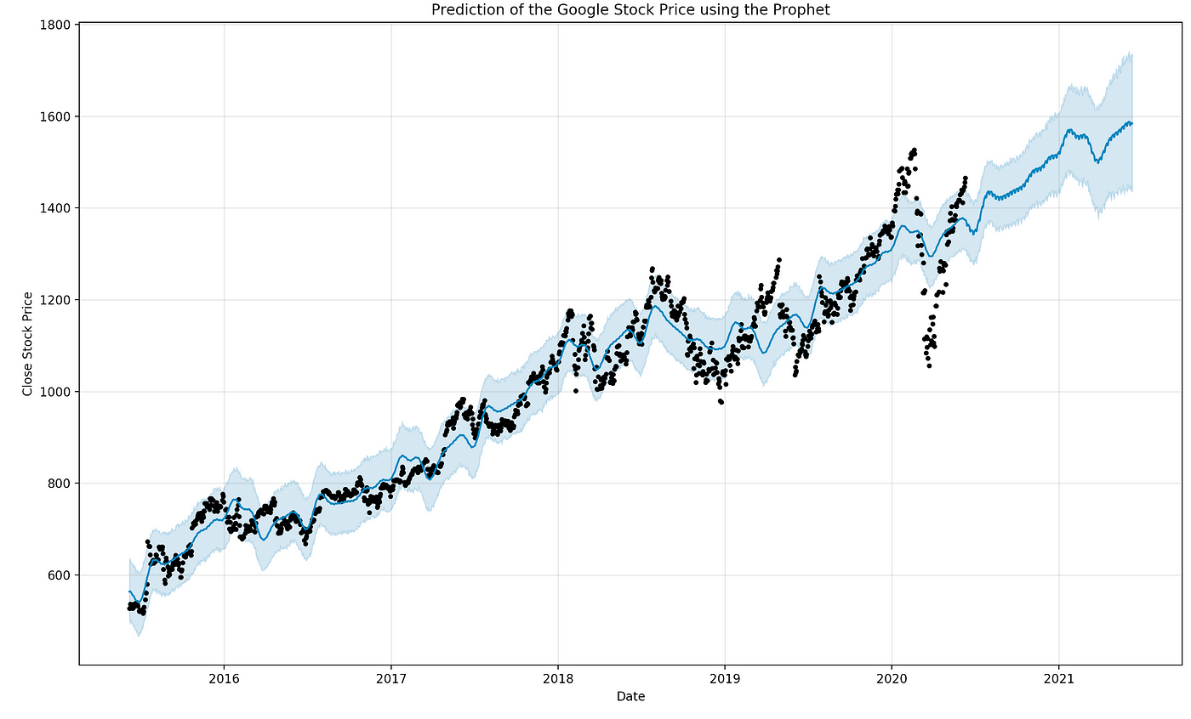
Time Series (Financial)
Loukas 2020

Slide 17
Time Series (Financial)
Buczynski 2021

Slide 18
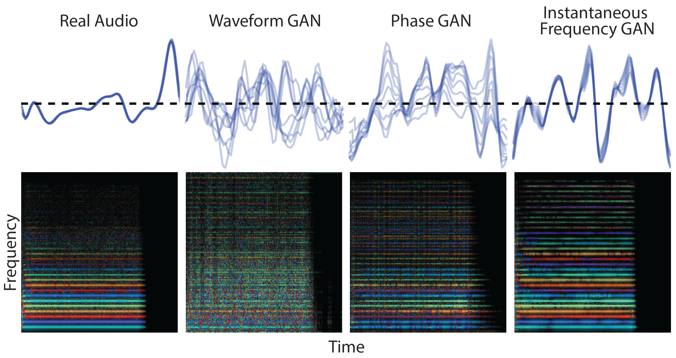
Time Series (Audio)
Engel 2019

Slide 19
Time Series (Text)
Jurafsky 2023

Slide 20
Health Care
Liu 2017

Slide 21
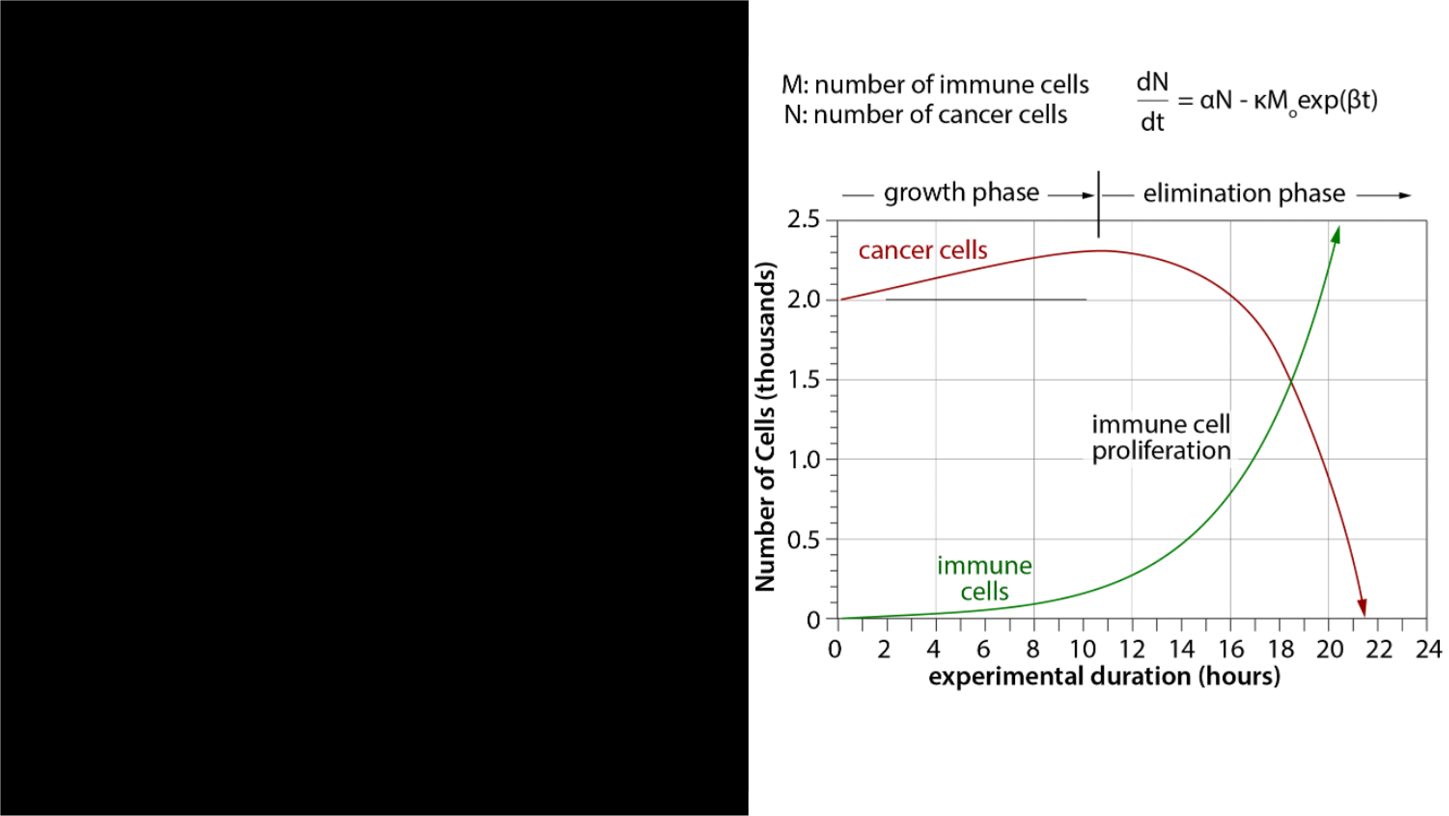
Analytic Solution
tumor cell doubling time: 36 hours
immune cell doubling time: 6 hours
immune cell killing rate: 2 hours

Slide 22
Comparison

Slide 23
ChatGPT
OpenAI 2023

Slide 24
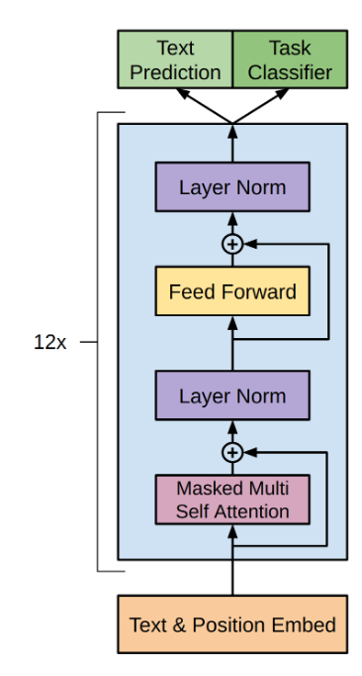
ChatGPT
OpenAI 2023

Slide 25
ChatGPT
OpenAI 2023

Slide 26
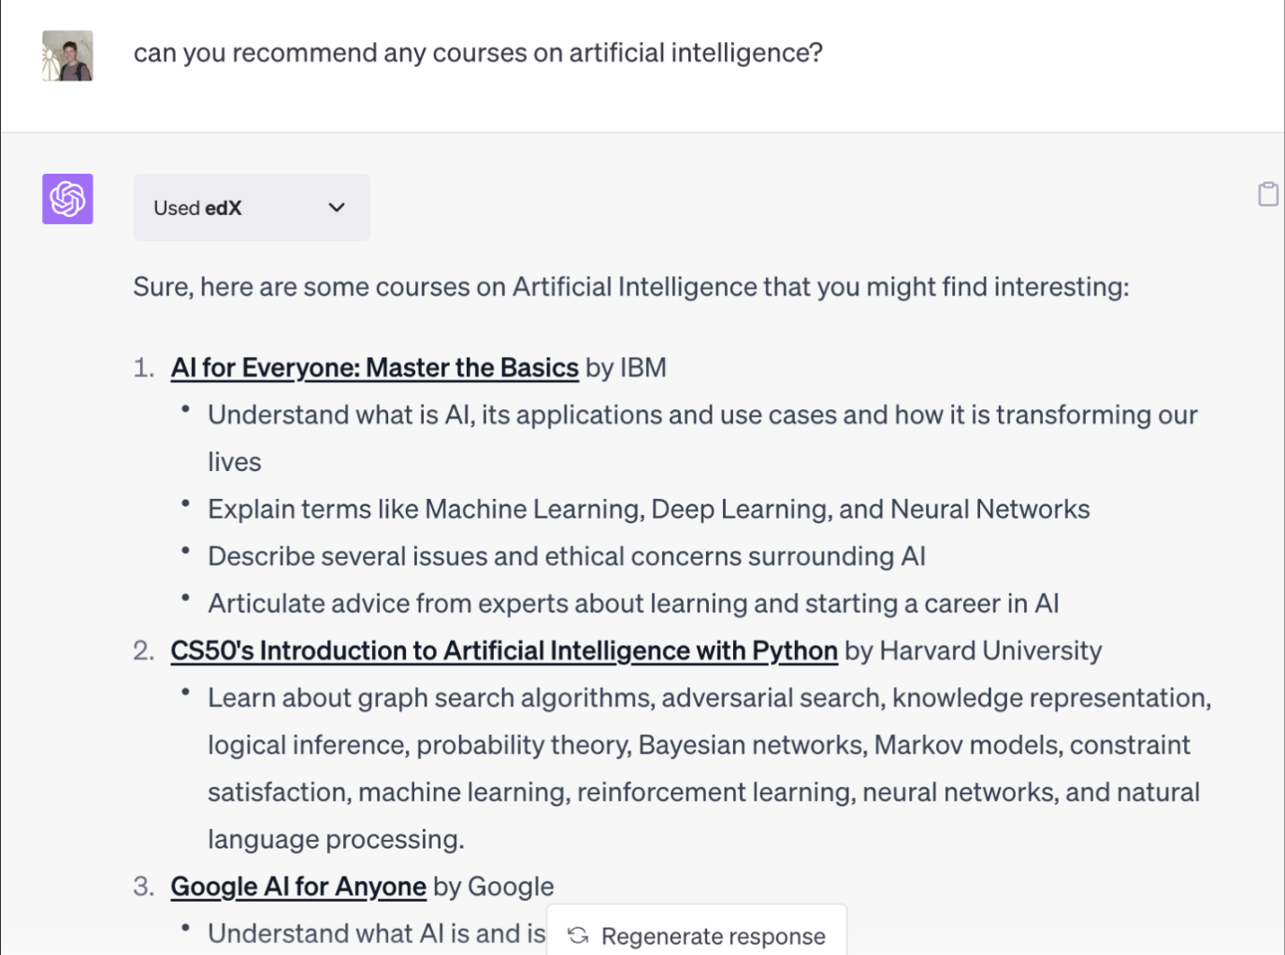
ChatGPT & Education
edX 2023

Slide 27
ChatGPT & Finance
Lopez-Lira 2023

Slide 28
Thank you!
Watterson 1993

