Slide 1
Whisper AI
Zachary Sayers
What is Whisper
How does it work
Application

Slide 2
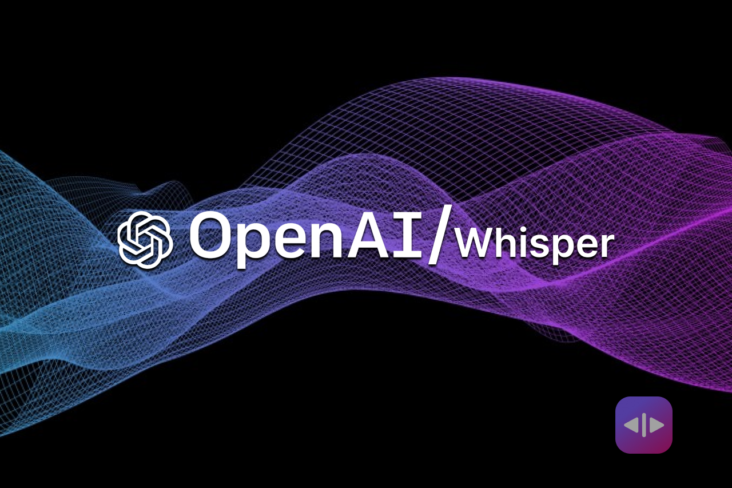
What is Whisper?
Highly accurate and robust Speech to Text Model
Trained on 680,000 hours of multilingual and multitask supervised data collected from the web
Capable of transcribing and translating multiple languages of speech/audio into text in its native language or English.

Slide 3
How Does it Work?
Notes:
Input audio is split into 30-second chunks, converted into a log-Mel spectrogram an is passed into encoders. Encoders have the task of organizing the position of words in a sentence. The Decoders transcribe and translate the audio given by using tokens (words said) to predict what words will be said next.

Slide 4
Application
Although the model is trained on hundreds of thousands of human speech from media such as interview’s, podcast, and TED talks, the robust generality of what the model knows is one of its downfalls when translating our transcribing nontraditional speech.
Niche types of language:
Dialects (Ebonics or African American English (AAE))
creole languages (Patois)
I am working on creating a model using Whisper, that is more tailored to understanding these niche languages, specifically Ebonics and discerning whether preexisting models can do so already.

