Slide 1
A LOOK AT TENSORS, DATASETS, AND DATALOADERS IN PYTORCH
July 5th, 2023
Bogotá, Colombia
Gabriel Ayoubi
UF Data Studio
Undergraduate Researcher
Notes:
Good Afternoon,
I hope everyone had a good 4th of July and got some rest. Today I would like to present some of my findings from the PyTorch tutorial sections on Tensors, Datasets and Dataloaders. A lot of this will probably be review as I am still working through the first half of the PyTorch tutorials and getting the hang of the library. If at any point in the presentation you would like to expand on something you found when working through the tutorial please do not hesitate to bring it up.

Slide 2
INTRODUCTION
Notes:
So, welcome to my presentation. My overall goal is to show the importance of these three concepts as they relate to machine learning and deep learning fields. After working through theses sections of the tutorial I feel that by delving into datasets, data loaders, and tensors, we can effectively handle and process data for training models in PyTorch because these concepts are the fundamentals of all deep learning and machine learning models.

Slide 3
DATASETS IN PYTORCH
PyTorch Offers Many Features for Machine learning
Standard datasets - including MNIST, CIFAR-10, and ImageNet.
Real Data - these real data sets offer several forms of input for models, such as audio, images and text.
Customizability - the platform allows users to upload their own data sets which is very useful for research and other applications.
Data Preprocessing – PyTorch allows for operations that can be used for data sets such as normalization, resizing and augmentation.
Notes:
Reading through the tutorial and following along helped me realize some of the important tools that PyTorch has to offer for its users. Standard datasets like MNIST which is used for handwritten digits in the training of image processing models, CIFAR-10 which contains images commonly used for image processing models as well as imagenet which is used for visual object recognition. Because these data sets are a part of PyTorch, they allow users to train models with data sets that contain tens of thousands of data points. In addition to these standard data sets, PyTorch also allows users to upload their own datasets. This is crucial for allowing users to create models because it allows for full control of the data which can obviously alter the results of training and running. PyTorch also allows users to normalize, resize or augment their data which is something that is crucial when working with smaller data sets.

Slide 4
CREATING CUSTOM DATA SETS IN PYTORCH
Creating Our Own Data Sets Gives us Flexibility
Custom datasets should implement the __len__ and __getitem__ methods to work properly.
Len returns the size of the dataset.
Getitem can retrieve sample data from the dataset with a given index.
The section with comments is where we would perform preprocessing.
This code is basic and should probably not be used but it gives a good overview of creating a dataset.
Notes:
The dataset class from PyTorch allows to create our data sets which can help us tailor our data to whatever model we are working on. The code you see on the left is some skeleton code for creating a custom data set. We can first subclass the torch.utils.data.Dataset class. We do this to create an interface where we can work with our custom data. Two methods, len and getitem are essential for creating custom data sets correctly. Len returns the size of the dataset, while getitem retrieves a specific data sample from the dataset given its index. Using getitem, we can perform any preprocessing. I left this section commented out as I’m still experimenting with the tutorial and want to see what PyTorch can do but this is the basic idea of creating a custom dataset.

Slide 5
DATA LOADERS IN PYTORCH
Data loaders are crucial for loading and processing data in a machine learning model
We can use the torch.utils.data.DataLoader class to handle data loading.
Data loaders are used for batching where we combines samples into batches for training efficiency.
Setting the shuffle parameter to True allows for the data to be randomized to prevent the model from memorizing the order of samples.
Parallel Data Loading allows the data to be loaded simultaneously using multiple CPU cores.
Notes:
Data loaders are an essential tool in PyTorch used to process data for training deep learning and machine learning models. The function of the dataloader class is to wrap and provide an iterable over a data set. It allows for efficient loading of data by using parallel worker threads. The class also allows for batching to help the model learn and categorize data. It also helps with shuffling of data to prevent the model from memorizing sample order which could affect the training and running of a model drastically. By using multiple CPU cores, the data loading process is sped up significantly by allocating multiple CPU cores. You can see all of these concepts in action in the code example on the right. Keep in mind this code will not run correctly in something like a Jupyter notebook because the custom_dataset has not been specified. This is a good start though and is a good way to see how the dataloader class can use all of these features to improve the data processing stage of a machine learning model.

Slide 6
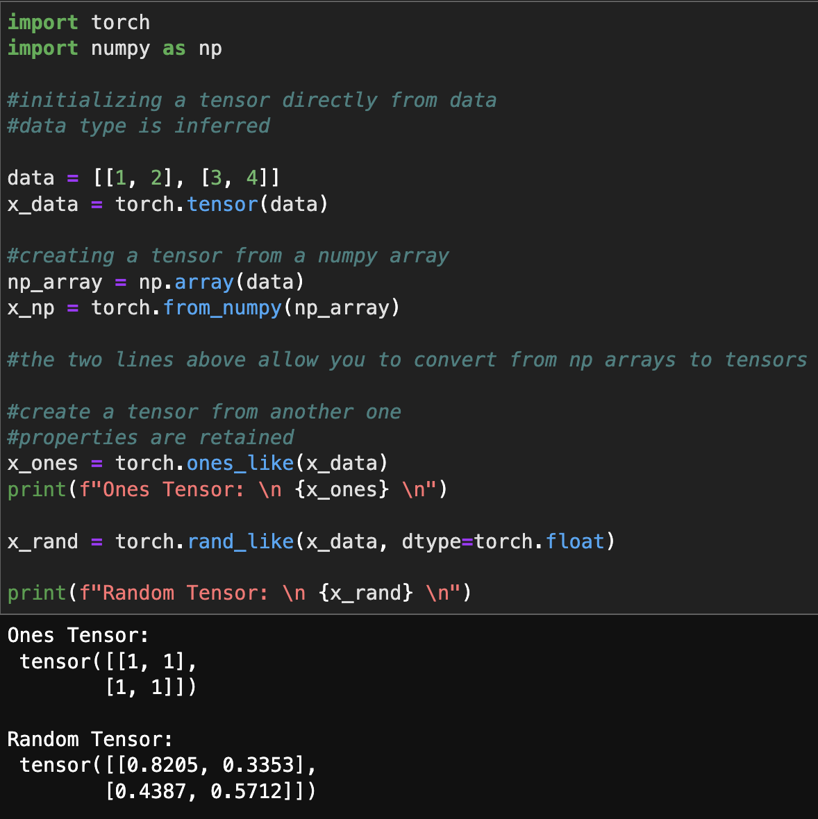
TENSORS IN PYTORCH
Tensors are the foundation of any machine learning model
Tensors allow for natural data representation in a model.
Tensors are also very mathematical in nature.
They are based on multi-dimensional arrays which allow for several computational operations from mathematical fields, primarily linear algebra.
These operations, along with GPU allocation, can be very useful when training a model.
Notes:
Let’s quickly discuss tensors. After going through the tutorial and watching some outside videos from YouTube on PyTorch, I have come to realize that tensors are an essential part of all learning models. I almost think of them as the meat and potatoes because of all the features they provide. Tensors can naturally present a collection of data because of their qualities as an array-based container with multidimensional characteristics. Training a model can become very easy when using tensors obviously because of all the mathematical tools they provide. Overall, data sets, data loaders and tensors are all concepts that are essential to machine learning models and are great ways to generate a creative model with unique data based on what the user wants.

Slide 7
A SPECIAL DAY
Notes:
I also threw this slide in because today is my birthday and I know Dr. Grant did mention to include some balloons in the presentation. Although I was not able to get balloons here’s a funny little graphic and a quick slide before I end with some questions.

