Slide 1
Transformers
A. R. Webber

Slide 2
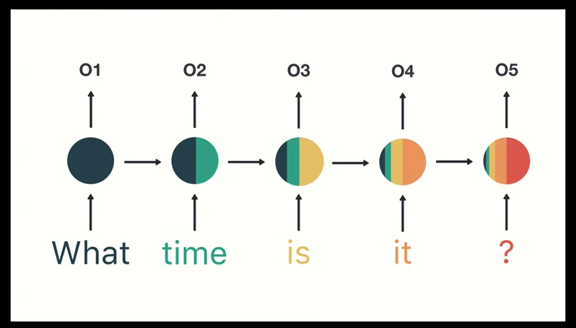
Reminder

Slide 3
Enter: Transformers!

Slide 4
Encoder-Decoder

Slide 5
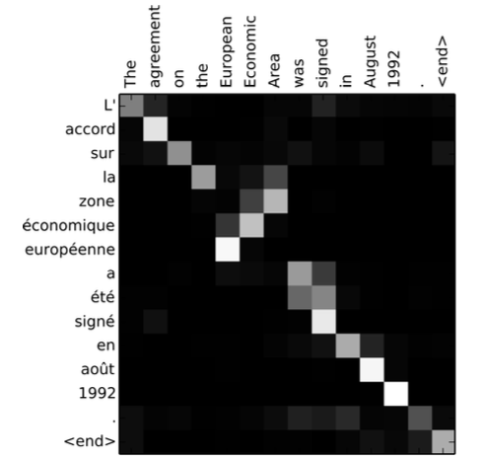
Attention

Slide 6
Self-Attention

Slide 7
Transfer Learning
Notes:
Difficult because of different libraries (PyTorch, TensorFlow)

Slide 8
End-to-End

