Slide 1
PyTorch Audio Presentation
Zachary Sayers
Pre-processing Audio for Deep Learning
Implementing a CNN for Sound Classification
Predictions with a Sound Classifier Trained with PyTorch

Slide 2
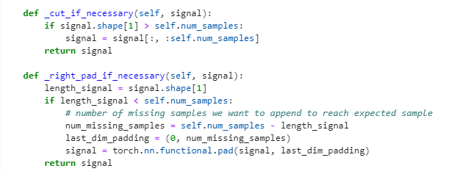
Pre-processing Audio for Deep Learning
Notes:
Resampling: If the sample rate of the loaded audio is different from the target sample rate specified
If the signal is longer than num_samples, it is trimmed to the desired length. If it is shorter, it is padded with zeros to match the desired length
*the code applies resampling using the functions _cut_if_necessary and _right_pad_if_necessary..
By performing these uniformization steps, the audio samples are processed consistently, making them suitable for input to a machine learning model.

Slide 3
Implementing a CNN for Sound Classification
What is a Convolutional Neural Network (CNN)?

Slide 4
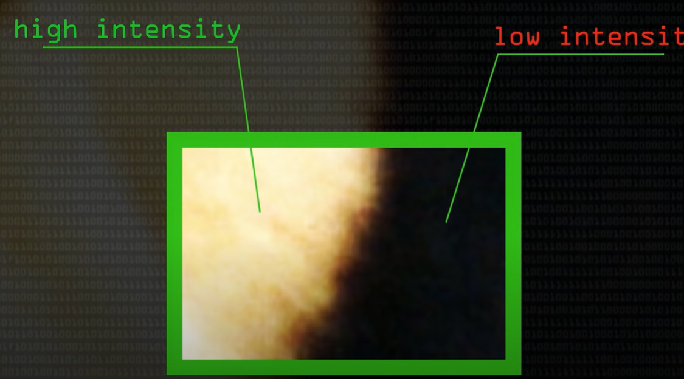
Kernel Convolution
Edge Detection
Notes:
The basics of CNN networks
Kernel convolution is a process where we take a small grid of numbers and we pass them over the whole image, transforming it based on what those numbers are. By using different numbers in the kernel, we can perform task such as blurs and edge detection.
we are trying to find out the amount of difference between the left and right side of an image in the kernel convolution grid to determine changes in color
*Edge Detection tries to find the regions in an image where we have a sharp change in intensity or a Sharp change in color a high value indicates a steep change, and a low value indicates a shallow change

Slide 5
Edge Detection
Notes:
convolutions of convolutions are analyzed by the model and weights are adjusted using a library that implements back propagation to move the weights in a direction that improves our model output

Slide 6
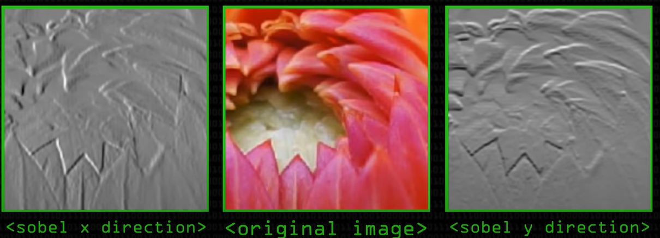
Implementing a CNN for Sound Classification
Great for image segmenting and image analyzation
How does this transfer over into sound classification?

Slide 7
Predictions with a Sound Classifier Trained with PyTorch
Notes:
Tutorial code only retrieved a batch size of 1
the loop iterates through the indices of the UrbanSoundDataset using range(len(usd)). For each iteration, it retrieves the input data and target label allowing me to print out the sample number, input data, and the predicted vs expected results.
Removing the print (input) statement from the code allowed me to analyze the model results in more of a concise manner.

Slide 8
Observations and Questions
Why is the model only proficient in classifying children playing and dog barking sounds?
Does training the model using the same method multiple times help, or do I have to change the code after each training session to see a difference?
Is the tensor signal information (input data) important?
Why were the training loss numbers so low given the numerous mistakes made in the model’s predictions?

