Slide 1
RNNs & LSTMs
Alexander R. Webber

Slide 2
Introduction
Feedforward networks are limited in their fixed neuron numbers
Does not allow for variable input and output sequences
Remembering things sequentially is helpful for us

Slide 3
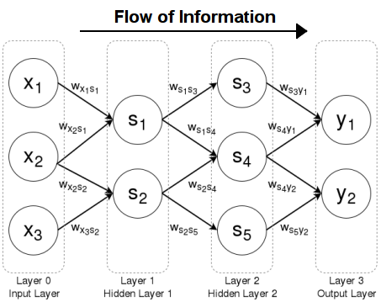
Classical Feed-Forward Neural Network

Slide 4
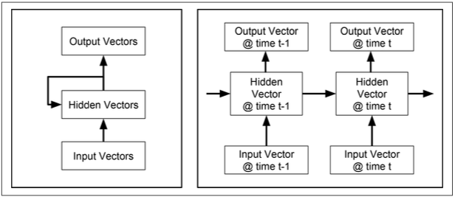
RNNs Architecture

Slide 5
Detailed NLP Example

Slide 6
Parts of Speech Labeling

Slide 7
Generative NLP Example

Slide 8
Simple NLP Example

Slide 9
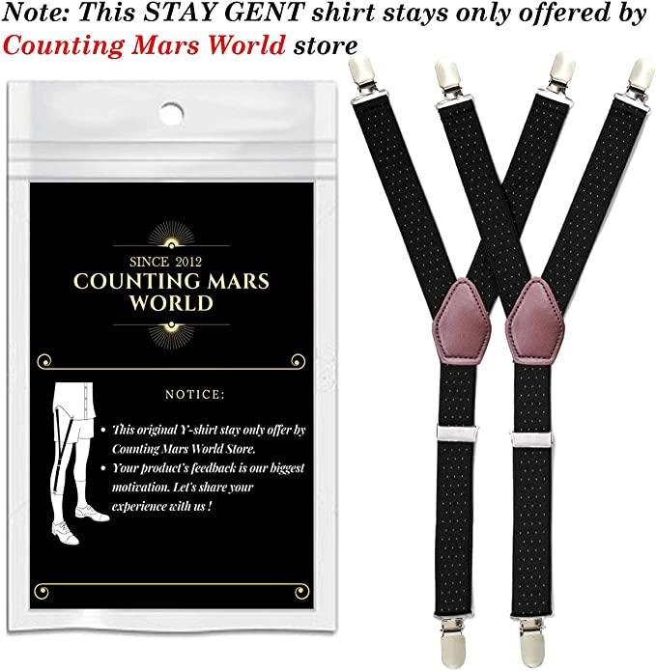
Need for LSTMs

Slide 10
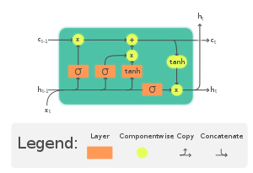
LSTMs

Slide 11
Detailed LSTMs

