Slide 1
PyTorch Audio Presentation
Zachary Sayers
6/10

Slide 2
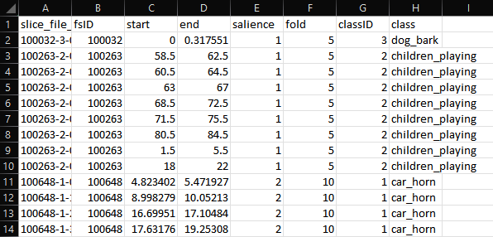
Making and Understanding Datasets
The urbansound8k dataset is composed of 8 columns
Slice_file
fsID
Start
End
Salience
Fold
ClassID
Class
Notes:
Waveform:
By visualizing the waveform, you can observe characteristics such as the duration, timing, and shape of the audio signal. It provides insights into the temporal properties of the audio, such as the presence of silence, transients, or periodic patterns.
Spectrogram:
The following spectrogram uses a Color normal map scheme (which is just a color progression scale with Dark blue being the lowest and warmer colors like red, orange, and yellow being the highest) to represent the magnitude or power of the frequencies.
Play audio

Slide 3
Main Label (Class ID)
Notes:
What is a epoch
An "epoch" refers to a complete pass through the entire training dataset
what is a loss in a AI neural network
"loss" refers to a value that quantifies how well the model is performing on a given task. I does this by comparing the predicted output of the model with the truth labels and produces a scalar value that represents the dissimilarity between them.
The lower the scalar value the better in terms of the models accuracy in its training.

Slide 4
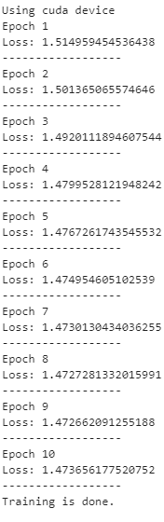
Model Results
Loss started at 1.5 and ended at 1.4.

Slide 5
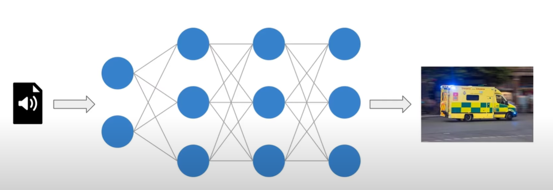
Benefits of Sound Classification
Gender Identification
Tone Identification
Linguistic Identification
  Location
  Race
  When the language was used

Slide 6
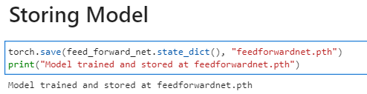
Observations and Questions
Where is my data stored?
In the tutorial Pycharm automatically made a “feedforwardnet.pth” document to keep track of the trained data.

Slide 7
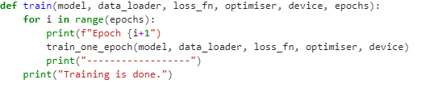
Observations and Questions
Jupyter Notebook environments aren’t the best for programming.
Lack of syntax error notifications
Doesn’t keep track of previously used variables and functions
Unconventional indentation rules
Is there any way for me to change the settings of Jupyter Notebooks so that it behaves more like and IDE like Pycharm?

