Slide 1
Deeper Dive into Semantics Segmentation
06/08/2023
Zoom
Amy Wu
Undergraduate Researcher
Rising Senior

Slide 2
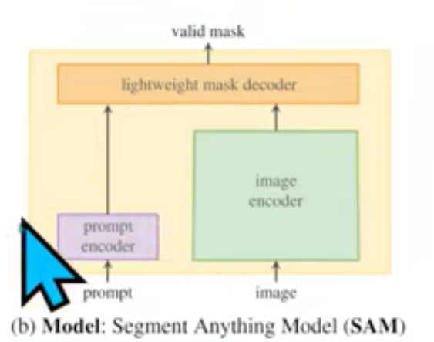
What is Segment Anything Model?
New foundational model for image segmentation
Meaning? Infinite image generation
Built a data engine for segmentation
How? Sudo labeling
Can be prompted with spatial or text
What are those?
What is the problem?
Notes:
In other words
Large segmentation model with a lot of pre-trained data on a generic task
Using valid masks (predicts missing token in a process like BERT and CLIP)
A large transformer can bring out rich features and then do more stuff down the line (what SAM did)
Meaning?
Can take an image take a chunk and generic the chunk that is missing (infinitely)
Was very limited in the past with a lack of abundant training data
What is a data engine?
Uses sudo labeling: use model to label images and use images to train the model
Rinse and repeat in a circle
Context
Masks are not abundant since it is artificial
Bounding model boxes, mask segmentation model masks <- supervised learning era
Still working on that
Previously had people to go annotate these images manually
Getting a partial result and then correct it
Already partially assisted by models

Slide 3
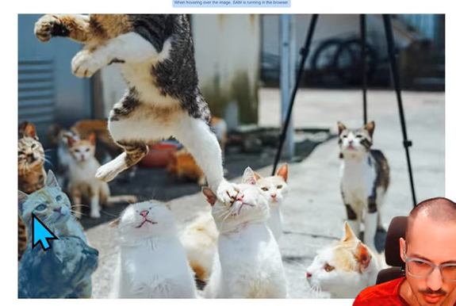
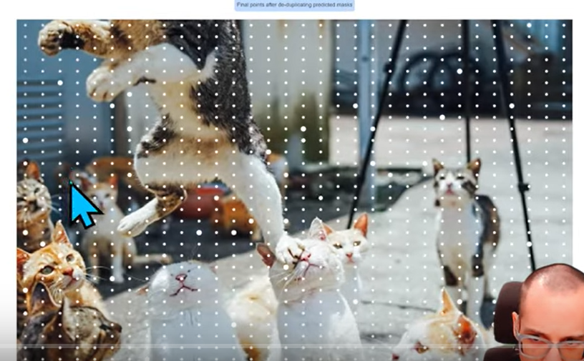
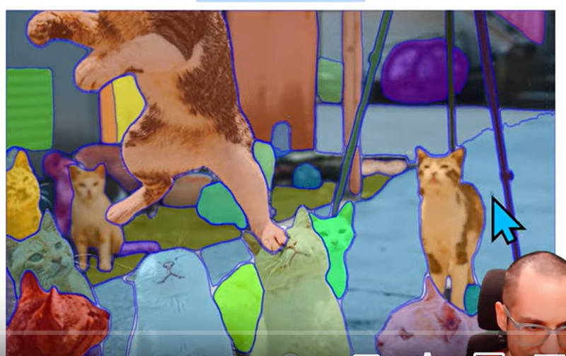
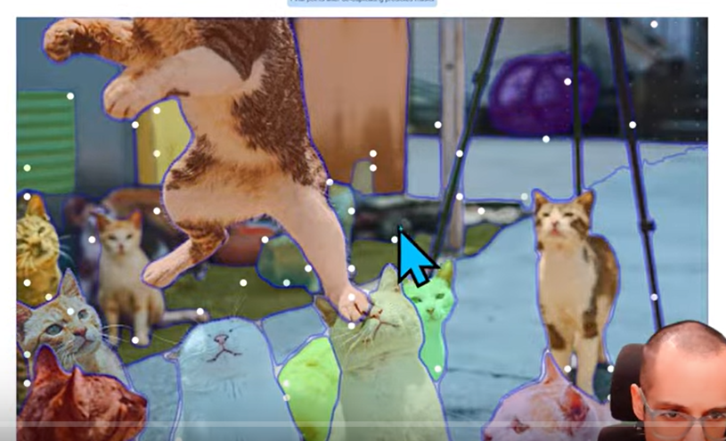
Semantics Segmentation in Action
Notes:
Creates all these points and then sample the image at these points
Does some kind of non mask suppression
Spatial info being used to get all the masks automatically
Spatial points -> single foreground point creating these high quality masks
Final dataset with 1 B m from 11 M images
Did top 1 or top 5 predictions (have multiple predictions and select the best prediction from that)
Runs on backend not web browser

Slide 4
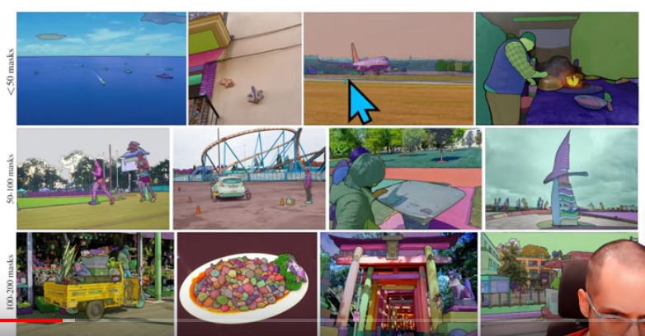
Segment Anything Model Images
Notes:
Impressive segmentation
Detecting small objects against big objects
A lot of detection of objects at once
Different sizes, huge amount of objects
Problems
Some parts of the objects are not captured entirely
Different sizes, huge amount of objects
ImageNet and ImageNetK
Are some of the other segmentation models specifically for Herculean with slices whereas these are for RGB images
One for Herculean scrolls with pretrained data

Slide 5
Inspiration
NLP
Also does semantic segmentation and instance segmentation
Task specific to task agnostic
But is it really a foundation model since it is majorly segmentation?
Tool former, but very secretive
Have a large data set, money, and assets like memory and time
Assisted Manual
Semi-Automatic Manual
Full-Auto Manual
Notes:
Uses NLP’s next token prediction task for prompt solving and pre-training
Tool former: large language models to use tools that can be segmentation models
Would be low resolution to speed things up
Minimally adapted and high level for secrecy
Had annotators to help for SAM
Helpful for object detection models good for localization

Slide 6
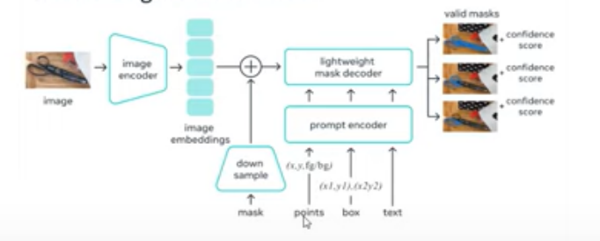
Segment Anything Model Process
Notes:
Transformer block that compresses image into 256 by 256 feature matrix, you use it on any image, passed into coder head for masks, and then get valid masks
In other words
Feed an image, get image embedding with vision transformer, have a mask that goes through a conf net and then gets concatenated with image embedding to mask out, takes in the three options by doing positional encodings for the prompts and a tokenized text, and then it comes up with valid masks
SAM would output multiple predictions via masks and put confidence scores
Ran mask decoders and prompt encoders fast while image encoder would be the longest
Has supervised learning, non-supervised learning, and self-supervised learning
Might crop images
Needs a specific version to your conda environment\
Python 3.8
PyTorch 1.7
TorchVision 0.8
OpenCV
Matplotlib
Pip install –e

Slide 7
Questions to Be Answered
What is CLIP?
What is amortized real-time?
What are the types of non mask suppression?
What are the Herculean scrolls and what do pre-trained models have to do with it?
What are multi class segmentation, multi channel segmentation, and binary segmentation?
Notes:
CLIP:
Uses image embedding and prompts in its encoder
Uses text prompts in segment
How the code block changes based on its parameters (like how below the threshold more images going through increase to stop junk going through score threshold is after segmentation whether to leave specific objects out)
- Know the output of it would be a dictionary of masks

Slide 8
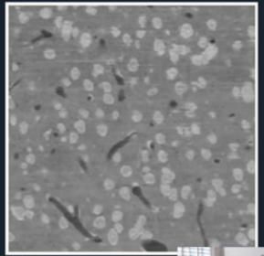
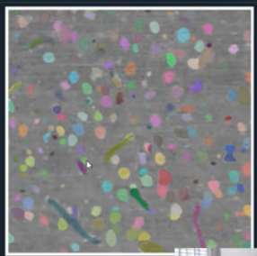
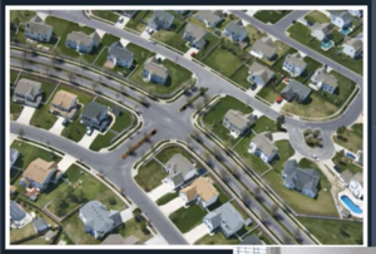
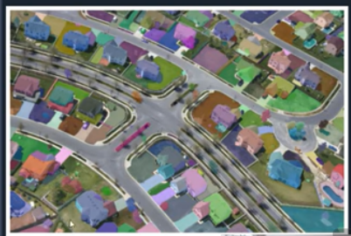
Questions To Be Answered
Notes:
CLIP:
Uses image embedding and prompts in its encoder
Uses text prompts in segment
How the code block changes based on its parameters (like how below the threshold more images going through increase to stop junk going through score threshold is after segmentation whether to leave specific objects out)
- Know the output of it would be a dictionary of masks

