Slide 1
PyTorch Audio Presentation
Zachary Sayers

Slide 2
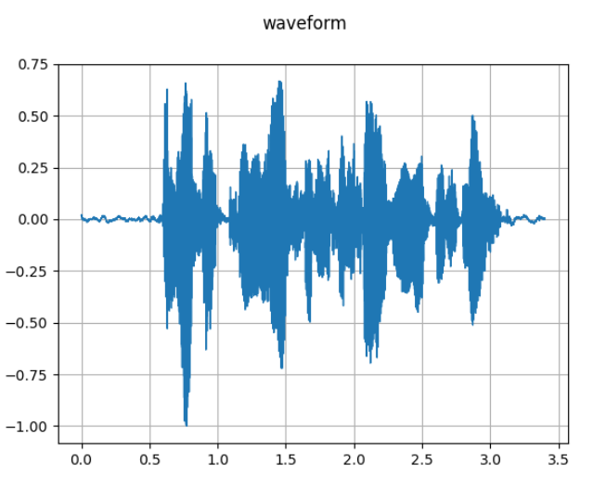
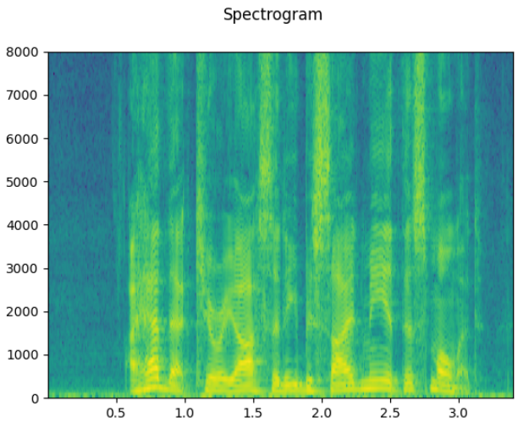
PyTorch Audio Tutorial
Waveform vs Spectrogram
Waveform and spectrogram are two different representations of audio signals that provide different types of information.
Waveform:
shows how the amplitude of the audio signal varies over time.
x-axis represents time
y-axis represents the amplitude or intensity of the audio signal
Spectrogram:
a 2D visualization that shows how the frequency content of the audio signal changes over time.
x-axis represents time
y-axis represents frequency
Notes:
Waveform:
By visualizing the waveform, you can observe characteristics such as the duration, timing, and shape of the audio signal. It provides insights into the temporal properties of the audio, such as the presence of silence, transients, or periodic patterns.
Spectrogram:
The following spectrogram uses a Color normal map scheme (which is just a color progression scale with Dark blue being the lowest and warmer colors like red, orange, and yellow being the highest) to represent the magnitude or power of the frequencies.
Play audio

Slide 3
PyTorch Audio Videos
From video two (Implementing and Training a Neural Network with PyTorch)
I learned how to
Download a dataset
Create a data loader
Build a feedforward neural network model
Train a model
Save trained model
Key Terms Learned:
Epoch
Loss
Notes:
What is an epoch
An "epoch" refers to a complete pass through the entire training dataset
what is a loss in an AI neural network
"loss" refers to a value that quantifies how well the model is performing on a given task. I does this by comparing the predicted output of the model with the truth labels and produces a scalar value that represents the dissimilarity between them.
The lower the scalar value the better in terms of the model's accuracy in its training.

Slide 4
Model Results
Loss started at 1.5 and ended at 1.4.

Slide 5
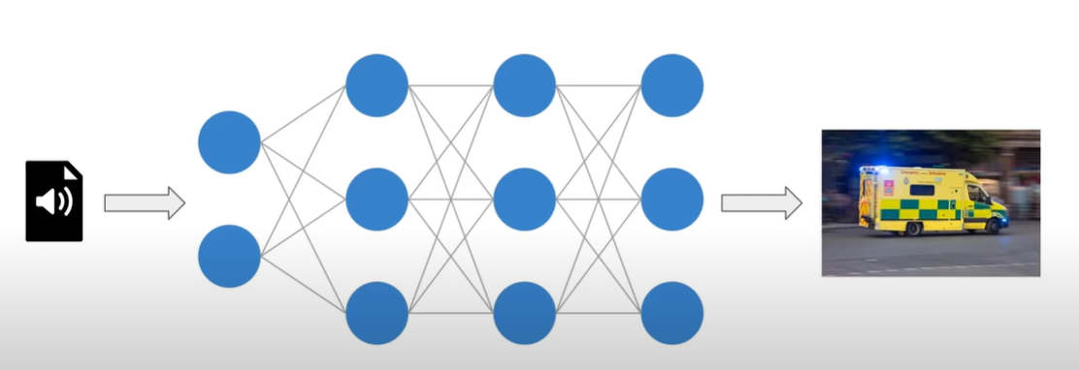
Benefits of Sound Classification
Gender Identification
Tone Identification
Linguistic Identification
Location
Race
When the language was used

Slide 6
Observations and Questions
Where is my data stored?
In the tutorial Pycharm automatically made a “feedforwardnet.pth” document to keep track of the trained data.

Slide 7
Observations and Questions
Jupyter Notebook environments aren’t the best for programming.
Lack of syntax error notifications
Doesn’t keep track of previously used variables and functions
Unconventional indentation rules
Is there any way for me to change the settings of Jupyter Notebooks so that it behaves more like and IDE like Pycharm?

