Slide 1
Semantics Segmentation & PyTorch Tutorial
06/01/2023
Virtual
Amy Wu
Undergraduate Researcher

Slide 2
Introduction
PyTorch
Semantics Segmentation
Progress
Issues
Solutions

Slide 3
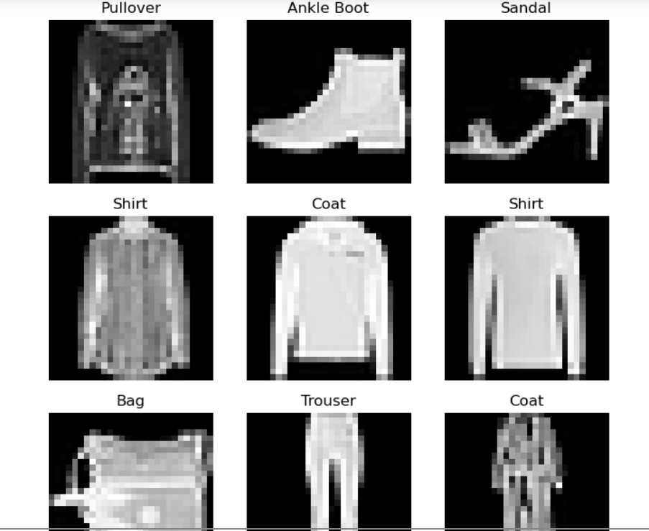
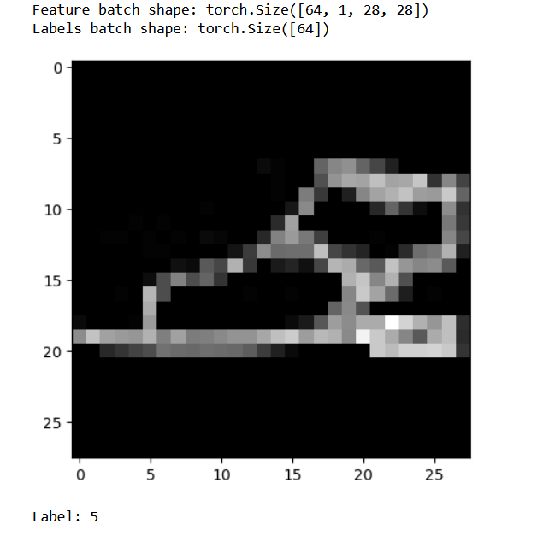
PyTorch Tutorials
Load in dataset
Transform
Run minibatches
Backpropagation and gradients
Epochs and losses
Optimization and training loops
Save and load models

Slide 4
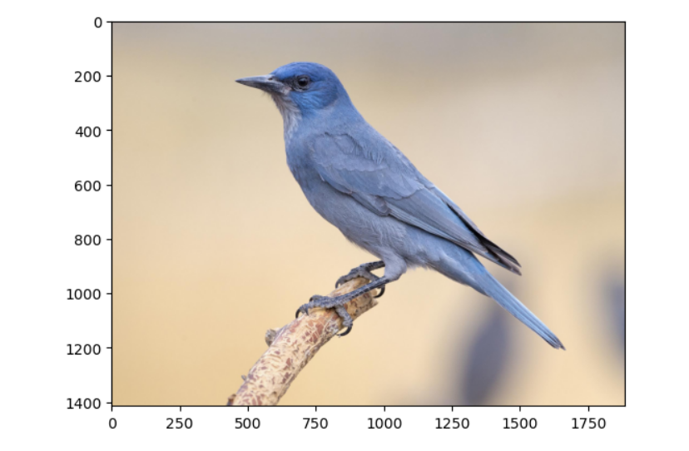
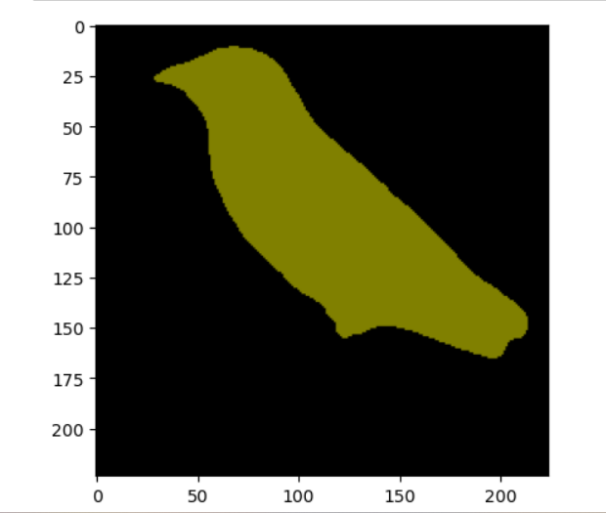
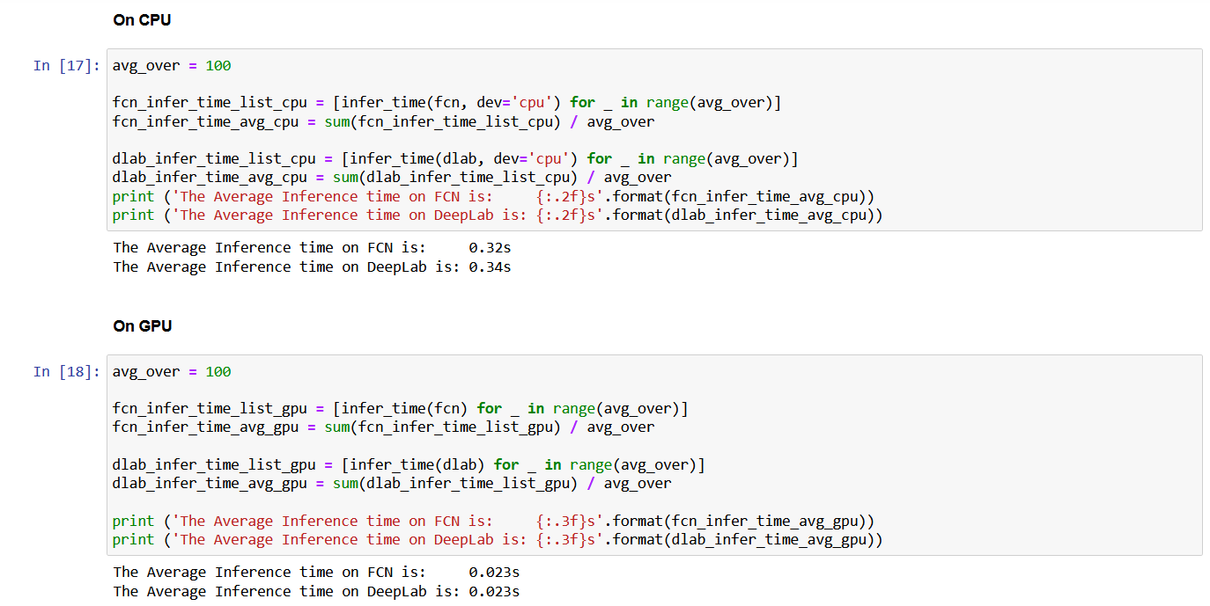
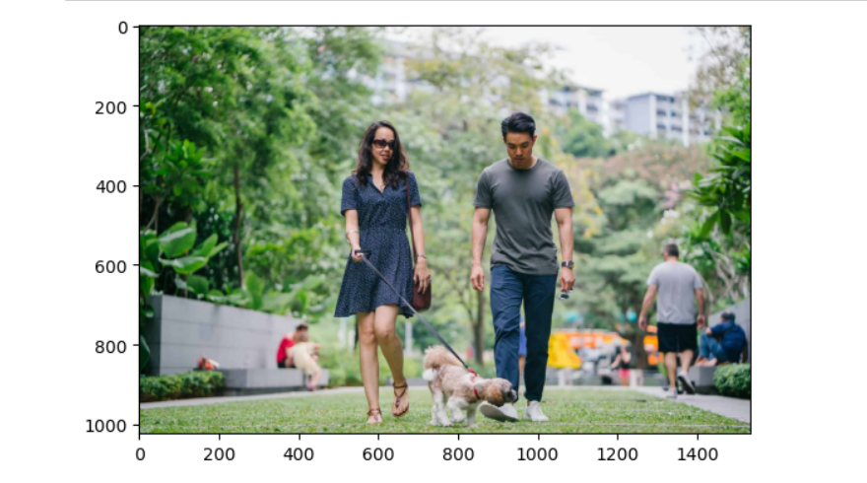
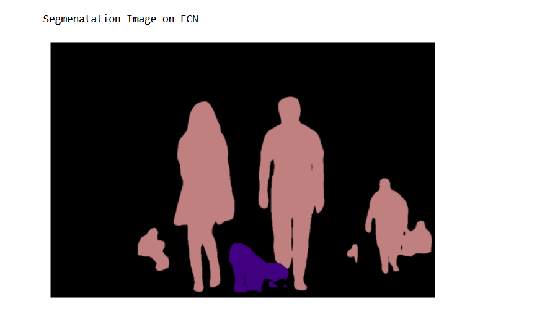
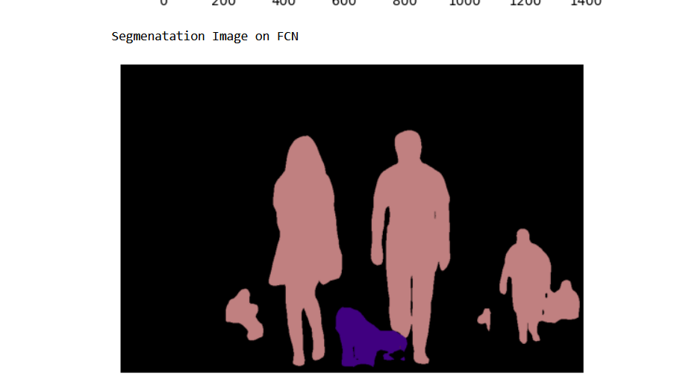
Semantics Segmentation

Slide 5
PROGRESS
Went through PyTorch tutorials
In process of Segmentation Semantics
Issues
Solutions

Slide 6
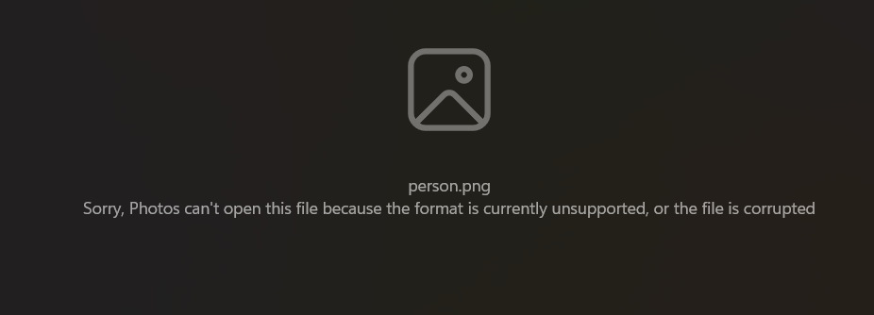
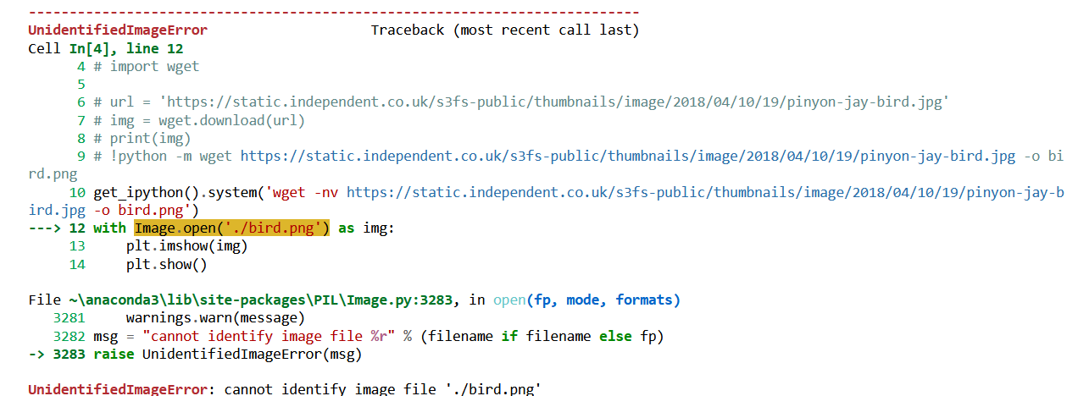
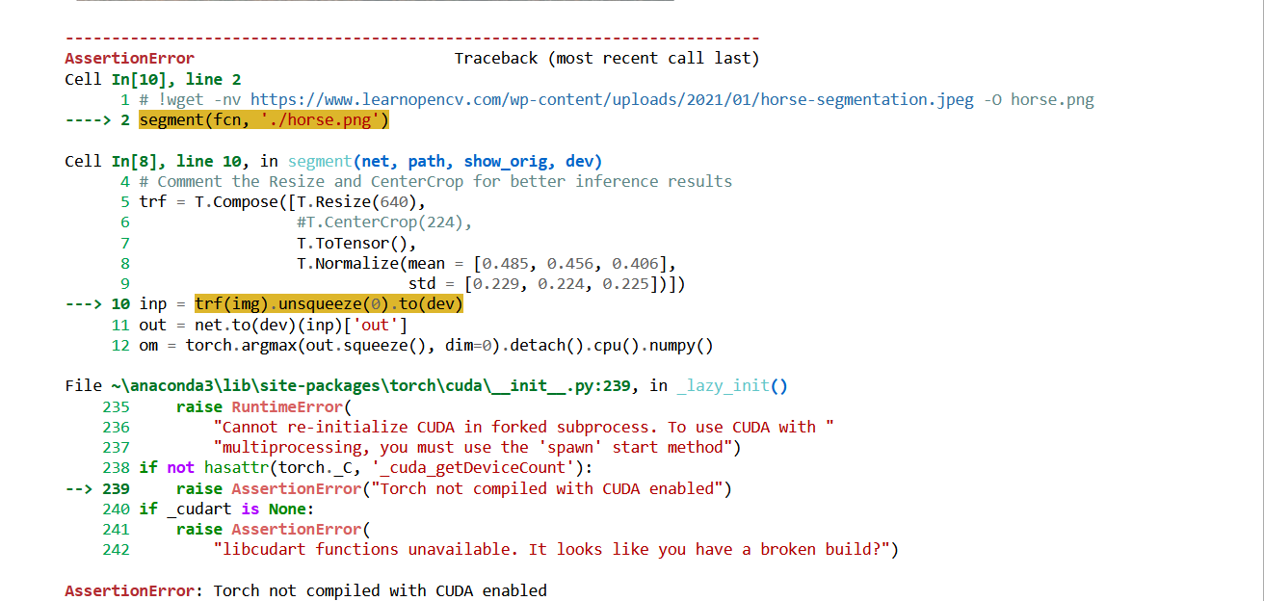
Issues
Wget
Had to reinstall
Still in the process of fixing
Mod Security
Older version
1 byte images
PyTorch Vision
CUDA build
Old version
resnet
Missing

Slide 7
Solutions
PyTorch Vision
!pip install _______
CUDA build
Have to get an updated version for Torch

Slide 8
Next Steps
Fix wget version issue
Fix resnet missing file
Understand more
Tagging more photos

