Slide 1
Mixtec Codices
Alexander R. Webber

Slide 2
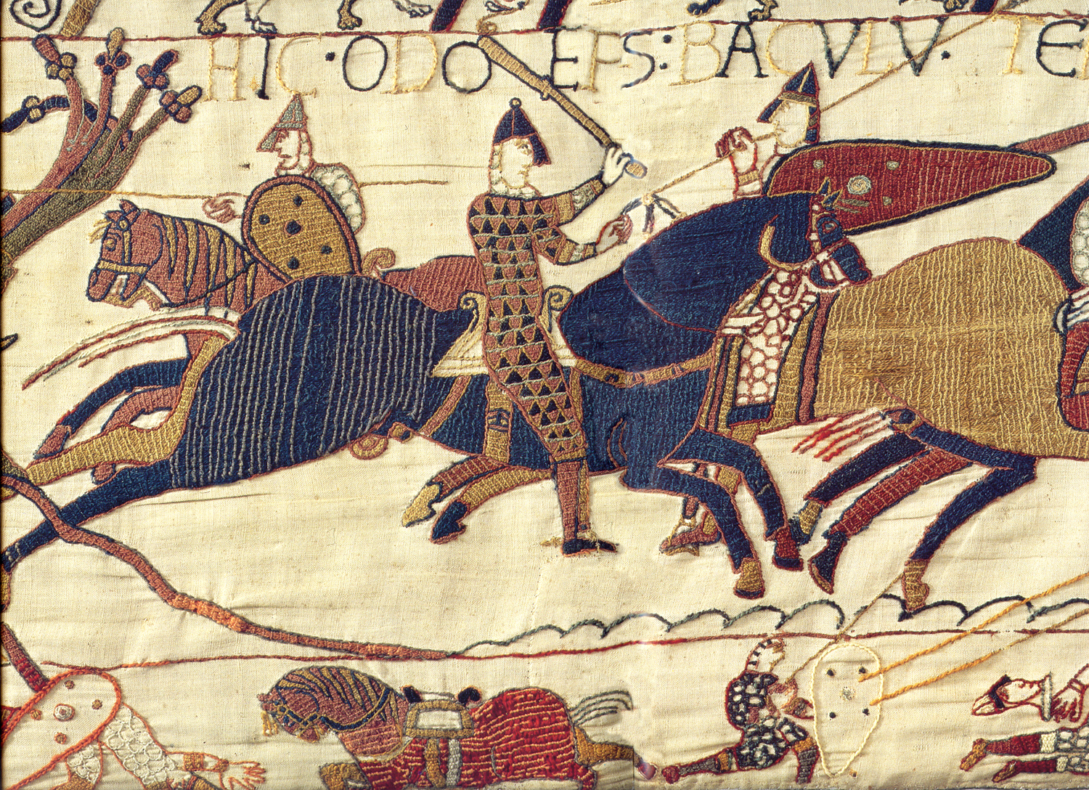
Writing Systems
Mixed interpretations
Culturally dependent
Broad Definition
Notational system
Glottographic vs. Semasiographic
Notes:
Mixed interpretations
Cortés
Accepted as writing
Fr. José de Acosta
Skeptical
DeFrancis
Felt it was an earlier evolution
Sampson
On par with
Culturally Dependent
Writing exists only in a civilization and a civilization cannot exist without writing
Broad Definition
Phonetic writing
Glyph
Musical Notation
Math
Chemistry
At times superior to phonetic writing for special cases, including cultural
Notational system
Record the facts of the present and the past and to look toward the future.
The communication of relatively specific ideas in a conventional manner by means of permanent, visible marks.
What gives any particular element of a language its role in the language is not its superficial physical properties but, rather, the relationships it enters into with the other elements of the language.
Writing as a storage system
Plan
Imagine
Reflect
Glottographic vs. Semasiographic
Phonetic vs glyphic
Semasiographic communicates information within the structure of its own system; does not need to detour through speech.

Slide 3
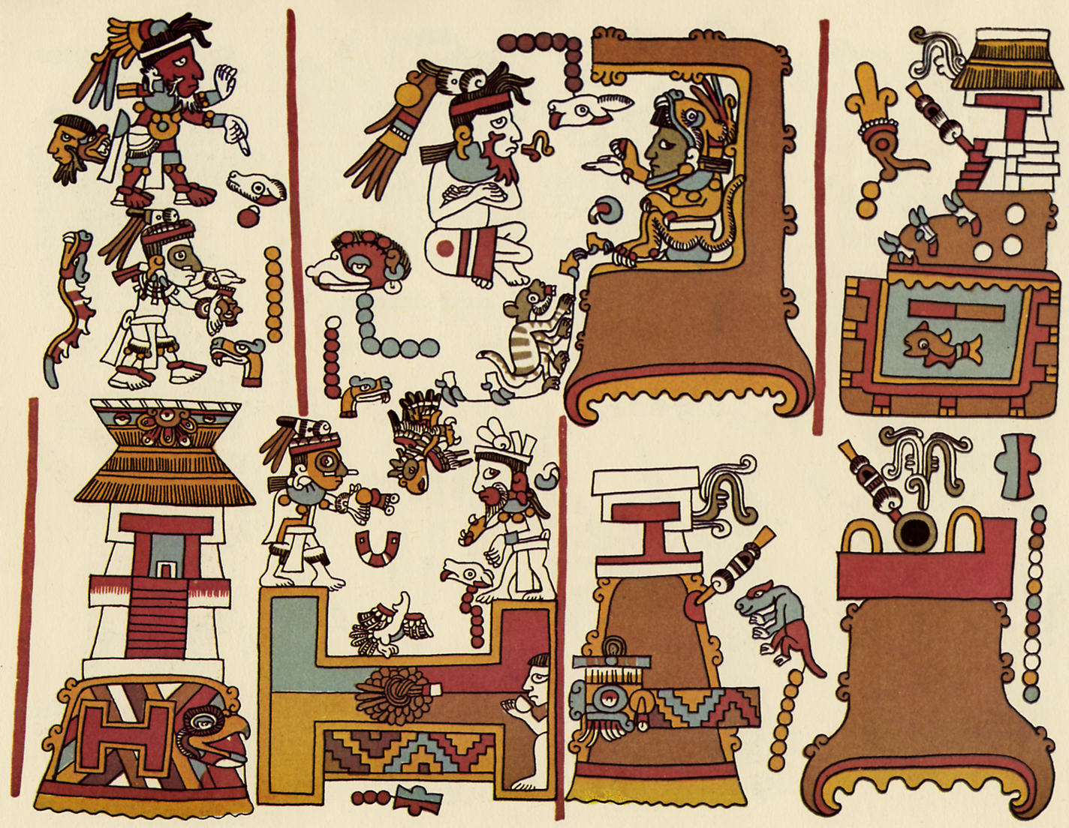
Semasiographic Systems
Conventional vs. Iconic
Still used
Functions beyond geographical boundaries
Mixtec vs. Aztec
Notes:
Conventional vs. Iconic
Conventional cannot be understood in and of themselves
Iconic systems can be understood to a degree by outside observers, but still require a sharing of the visual culture behind the system
Bear some likeness to or visual association with the ideas, things, or actions they represent
Still used
Signs at airports
Computer systems prioritize semasiographic systems
Mac vs MS-DOS
Functions beyond geographical boundaries
Rising in popularity along with globalism
Style was shared across the Mexican valleys & peninsula
Mixtec, Aztec, Nahuatl, Otomi, Totonac, Chocho, Zapotec, Tlapenec
Mixtec vs. Aztec
Aztec often used both purely pictorial/artistic elements and narrative glyphs for different purposes
Mixtec integrates both; the pictures have direct communicative purposes

Slide 4
Mixtec Vocabulary - Date & Quantity
Notes:
Known as “tacu”
Some combinations could be day or year, such as 1 Rabbit, while others could only be a day, like 1 Flower.
Mixtec scribes use the A-O notation to designate specifically year

Slide 5
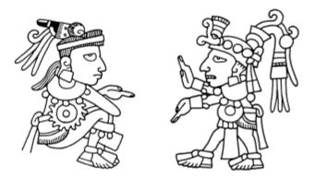
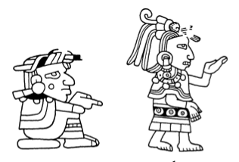
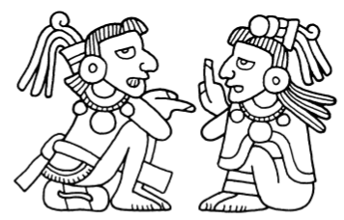
Mixtec Vocabulary – Sex & Age
Males
Females
Aged
Notes:
The manuscript painters always identified individuals as being male or female, and they additionally could characterize them as having a particular rank, status, or occupation (elder, ruler, warrior, priest, etc.)
Mixtec men often have bands around their ankles/calves, wear loincloths, and have lip plugs
Women hair is usually longer in in some sort of braid or twist, often looking like horns on their head, as well as have long skirts, called huipil. Women of childbearing age are usually shown as naked.
Older people are shown with scraggly hair, drooping lips, and no teeth or a single tooth.

Slide 6
Mixtec Vocabulary – Sex & Age
Males
Females
Aged
Notes:
The manuscript painters always identified individuals as being male or female, and they additionally could charac-
terize them as having a particular rank, status, or occupation (elder, ruler, warrior, priest, etc.)
Mixtec men often have bands around their ankles/calves, wear loincloths, and have lip plugs
Women hair is usually longer in in some sort of braid or twist, often looking like horns on their head, as well as have long skirts, called huipil. Women of childbearing age are usually shown as naked.
Older people are shown with scraggly hair, drooping lips, and no teeth or a single tooth.

Slide 7
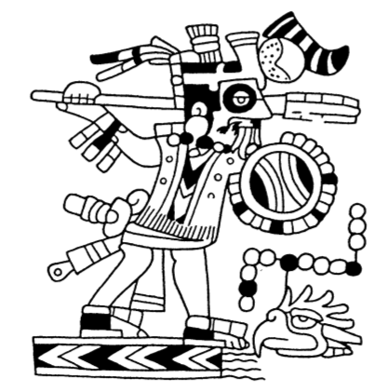
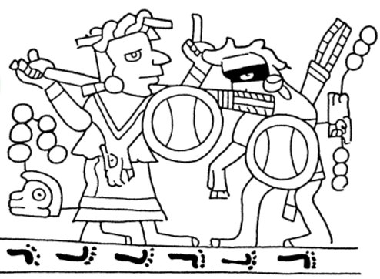
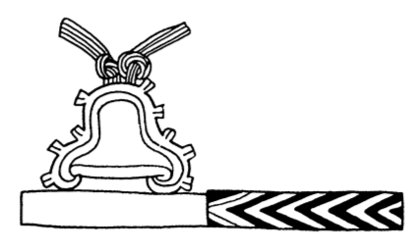
Mixtec “Grammar”
Notes:
As grammar dictates the order and relationship between words, as well as the meaning of their composition, so too do Mixtec Codices have an order and relationship between icons that give rise to meaning. First is conquer, second is warpath, third is enemy territory.

Slide 8
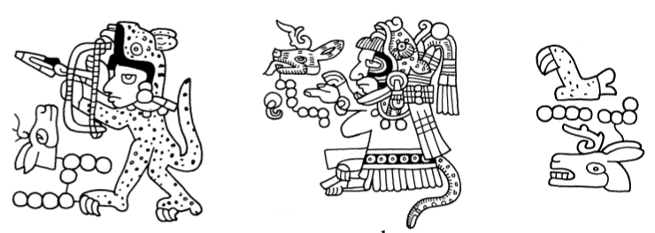
Mixtec Names
Lord 8 Deer, Jaguar Claw
Notes:
Mixtec names were decided based on when someone was born, and indicated by that month sign along with a number of beads for the day.

Slide 9
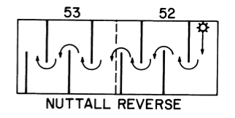
Mixtec Reading Order
Notes:
Different screenfolds have different purposes and also have different patterns, so their interpretation requires some of that previous. For instance, genealogical screenfolds run a boustrophedon pattern, like an ox plowing a field, whereas event-oriented screenfolds run unidirectional, from one side of the page to the other. Red lines both dictated where scene began and where to look for the next one. These divisions are referred to as “registers” in the literature.

