Slide 1
Segment Anything
Notes:
Adapted from Remote Work (2011) and Essential Remote Work (2021)

Slide 2
Introduction

Slide 3
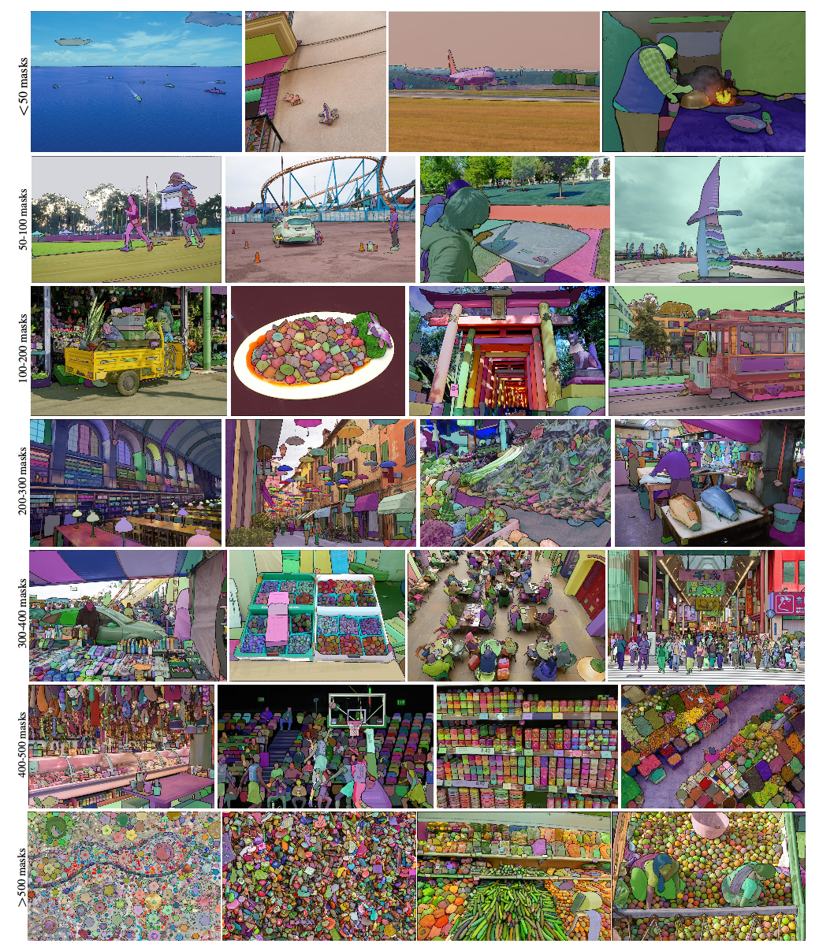
Task
Generate a set of masks given some input:
Dense:
Mask
Sparse:
Point
Box
Text

Slide 4
Model
Flexible Prompts
Real-Time Results
Ambiguity aware
(Amortized) Image Encoder
Prompt Encoder
Mask Decoder

Slide 5
Data-Engine
1-Billion Mask Dataset
Assisted-Manual
Semi-Automatic
Fully-Automatic

Slide 6
Responsible AI
Sourced from geographically and economically diverse locations
Performs similarly across groups of people

Slide 7
Experiments
Zero-shot/Few-shot testing on 23 datasets
Different than dataset model was trained on

Slide 8
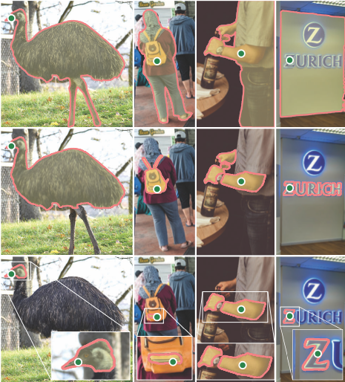
Segment Anything Task
Task
Pre-Training
Zero-Shot Transfer
Related Tasks
Discussion/Future Directions

Slide 9
Segment Anything Model
Image Encoder
Prompt Encoder
Mask Decoder
Ambiguity Resolution
Efficiency
Losses & Training

Slide 10
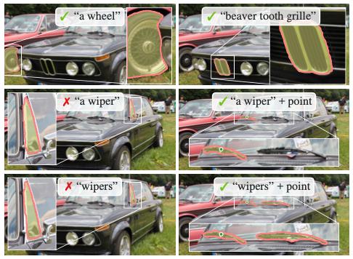
Segment Anything Experiments
Zero-Shot Single Point Valid Mask Evaluation
Zero-Shot Edge Detection
Zero-Shot Object Proposals
Zero-Shot Instance Segmentation
Zero-Shot Text-to-Mask

